Slide 1


Graduation Project:
Digital Transformation for Eclipse Anime
From problem analysis to full implementation using SDLC methodology
An Anime-themed E-commerce Platform
Done by:
Ali Abbadi, Mohammad Abdat , Mahran Abu sir
https://www.eclipseanime.com/
Supervisor:
Dr. Ahmad Nobani
An-Najah National University – MIS Department

Slide 2
Introduction
EclipseAnime is a new local store in Palestine that sells anime-themed products like figures, posters,
and clothing.
It aims to serve the growing anime community with high-quality items and a fun, creative shopping experience.
An-Najah National University – MIS Department

Slide 3


Problems:
Solutions:
No website to display or sell products
Customers limited to in-store only
Weak social media presence
No visual content for marketing
We built a full e-commerce website
Enabled online browsing and ordering
Created Instagram & Facebook pages
Designed posts using design tools
An-Najah National University – MIS Department

Slide 4


Our Vision:
To become the top anime store in Palestine by combining quality products with a strong digital presence.
Our Mission:
Offer a smooth online shopping experience.
Provide anime items fans love.
Share updates and engage with visitors through the website.
An-Najah National University – MIS Department

Slide 5

Step-by-Step Website Development Using Waterfall
Why We Chose the Waterfall Model
The project had clear and fixed requirements from the beginning
Each phase was completed before moving to the next
It fit our timeline and allowed organized planning
The website development had no frequent changes or iterations
It’s ideal for small projects with a defined scope like ours
An-Najah National University – MIS Department

Slide 6
Waterfall SDLC Steps
1
2
3
Requirements
Design
Implementation
6
5
4
Maintenance
Deployment
Testing
An-Najah National University – MIS Department

Slide 7


1
Requirements Gathering & Analysis
To clearly understand what is required from the website before starting the design or development phase.
Goal
The website is called Eclipse Anime. Its purpose is to offer organized and visual anime content for Arabic-speaking anime fans.
Project Idea
An-Najah National University – MIS Department

Slide 8

1
Requirements Gathering & Analysis
Target Audience
Age group: 13–30 years old
Passionate about anime and visual storytelling
Interested in browsing anime content quickly and easily
Need a website that is simple, responsive, and visually attractive
An-Najah National University – MIS Department

Slide 9
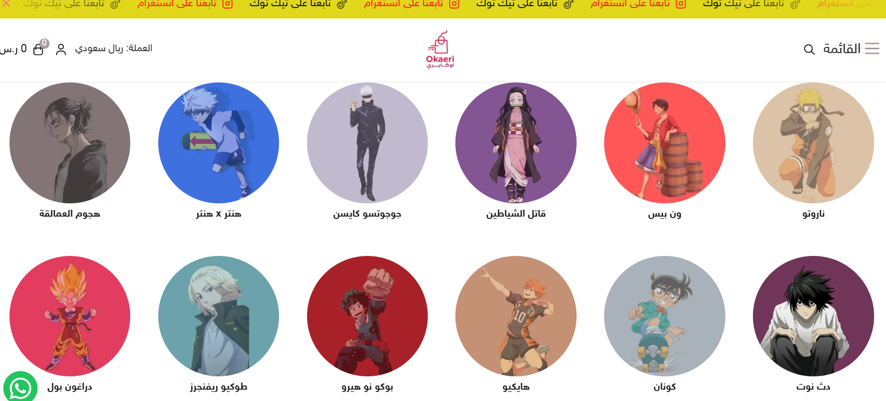

1
Requirements Gathering & Analysis
We gathered the Requirements by:
Analyzing similar websites like Okaeristore
Conducting brainstorming sessions within the team
Discussing common expectations of anime fans in our region
An-Najah National University – MIS Department

Slide 10
1
Requirements Gathering & Analysis
Functional Requirements
Non-Functional Requirements
Display anime details (name, description, image)
Enable filtering or searching for anime
Provide an attractive and easy-to-navigate homepage
Fast loading and smooth performance
Responsive design for mobile and tablet
Clean, well-structured code for maintainability and performance
An-Najah National University – MIS Department

Slide 11
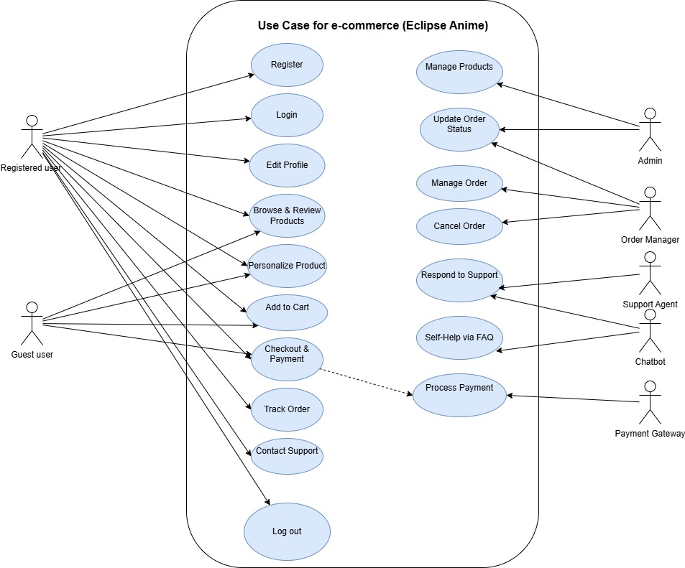
1
Requirements Gathering & Analysis
Behind the Scenes:
Our Use Case
An-Najah National University – MIS Department

Slide 12

2
System Design
We designed the website directly on WordPress, experimenting with different layouts and features.
Whenever we found a structure or style that worked well
,we adopted it immediately.
This hands-on approach allowed us to shape the site’s design in real time
An-Najah National University – MIS Department

Slide 13
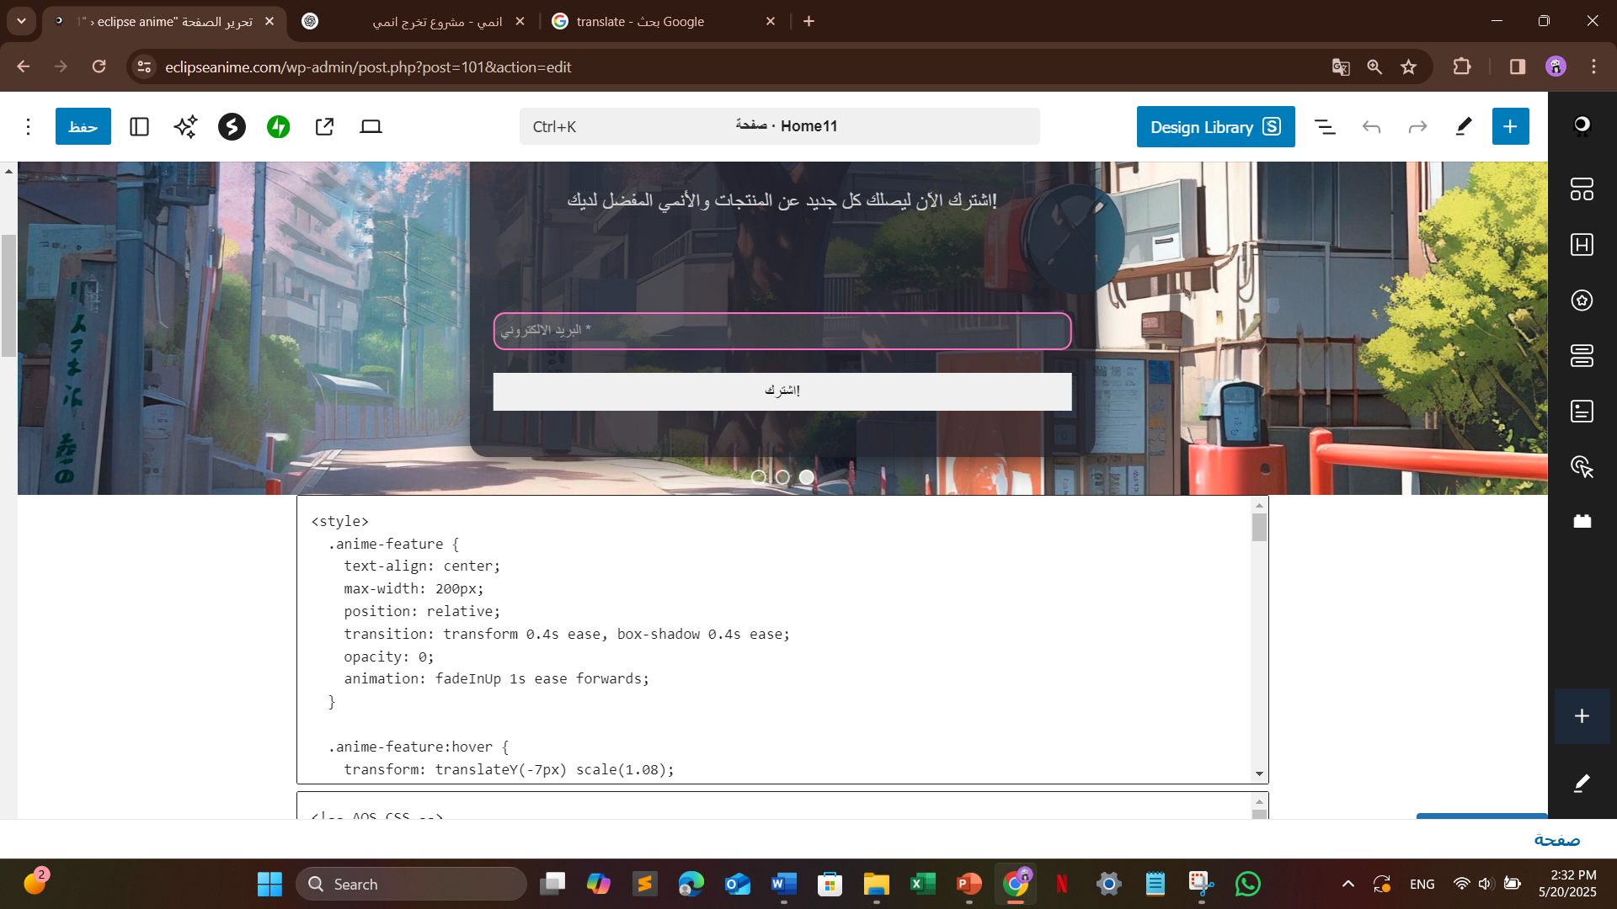
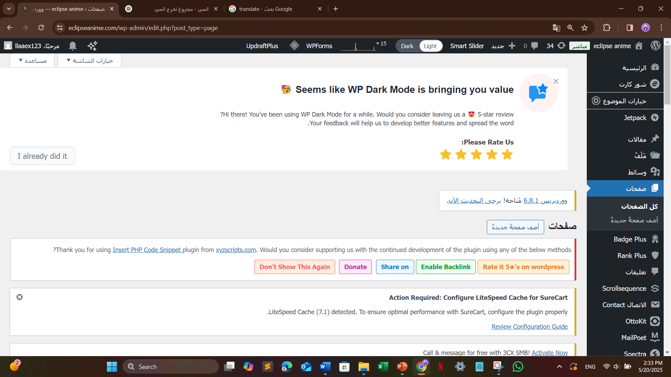
2
System Design
Admin Control & Content Editing:
We managed all content through WordPress admin panel,
where we created and edited products, blog posts, and pages manually.
An-Najah National University – MIS Department

Slide 14
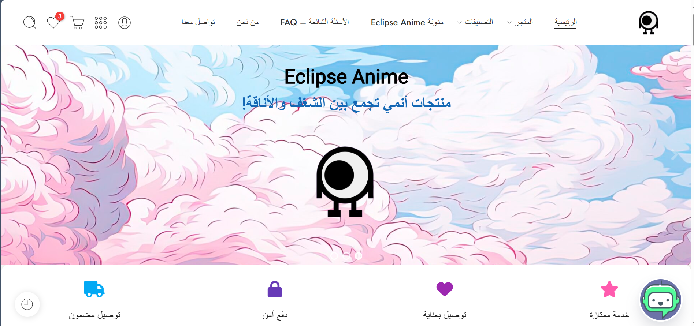
2
System Design
Home Page componants for example:
An-Najah National University – MIS Department

Slide 15
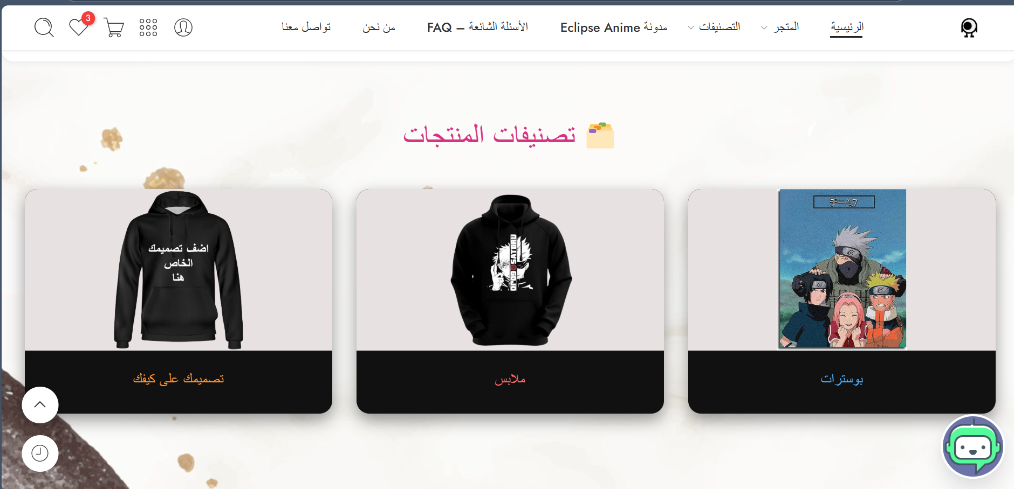
2
System Design
Home Page componants for example:
An-Najah National University – MIS Department

Slide 16
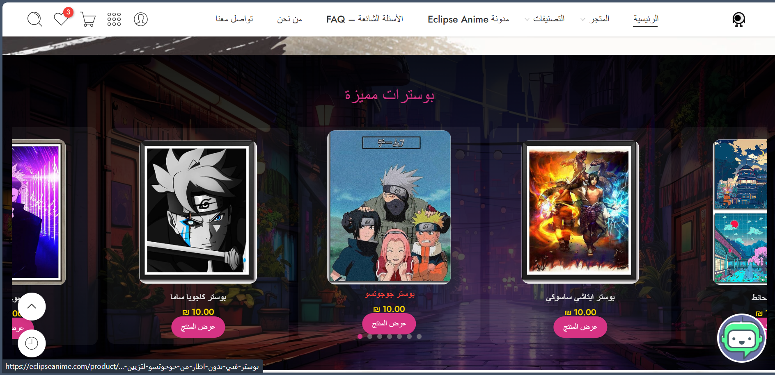
2
System Design
Home Page componants for example:
An-Najah National University – MIS Department

Slide 17
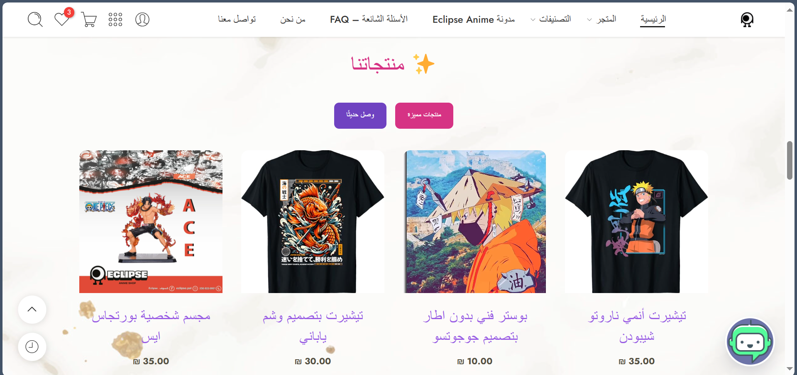
2
System Design
Home Page componants for example:
An-Najah National University – MIS Department

Slide 18
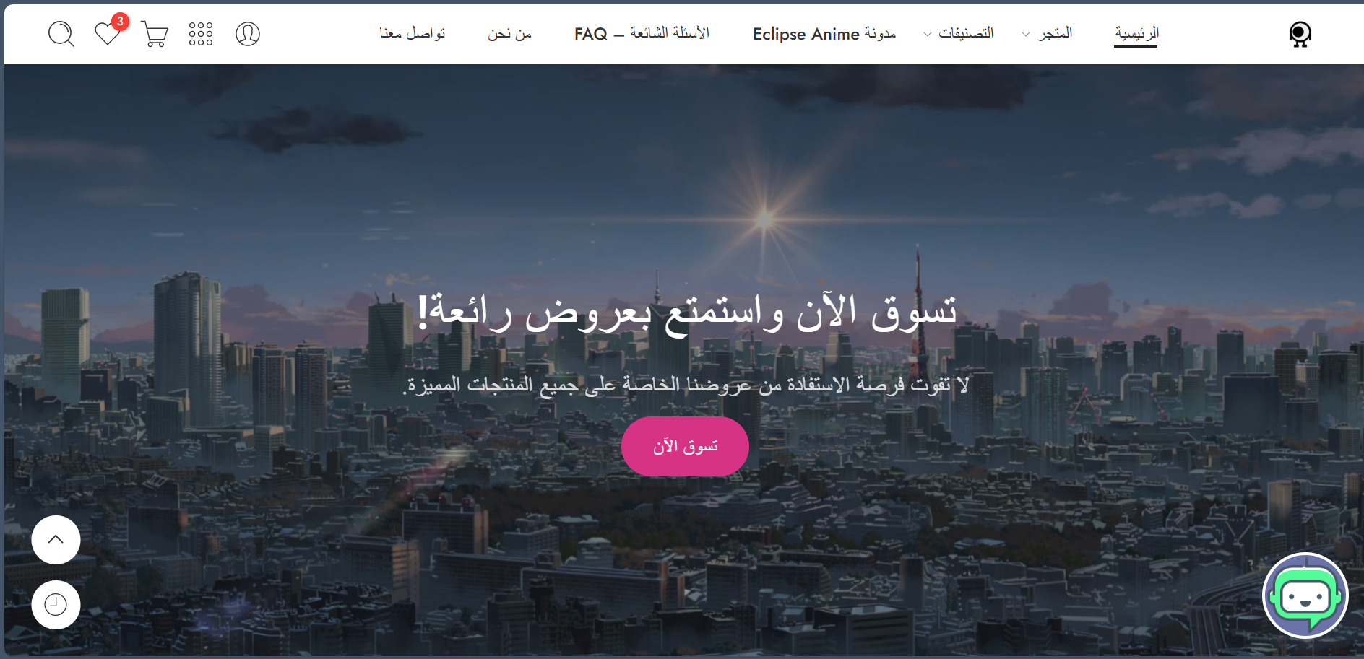
2
System Design
Home Page componants for example:
An-Najah National University – MIS Department

Slide 19
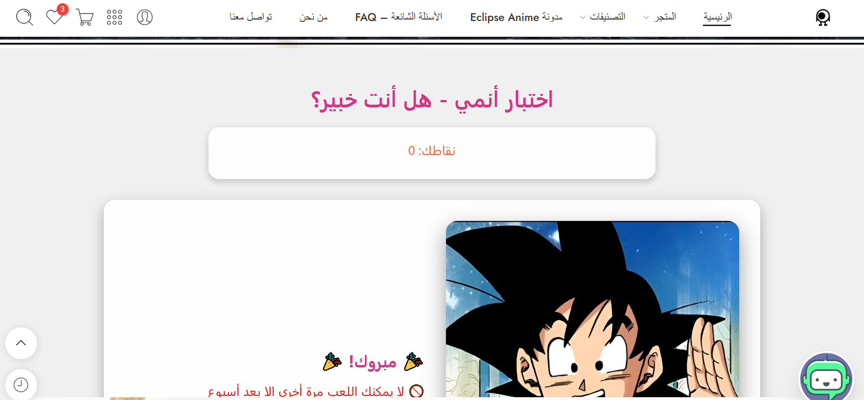
2
System Design
Home Page componants for example:
An-Najah National University – MIS Department

Slide 20
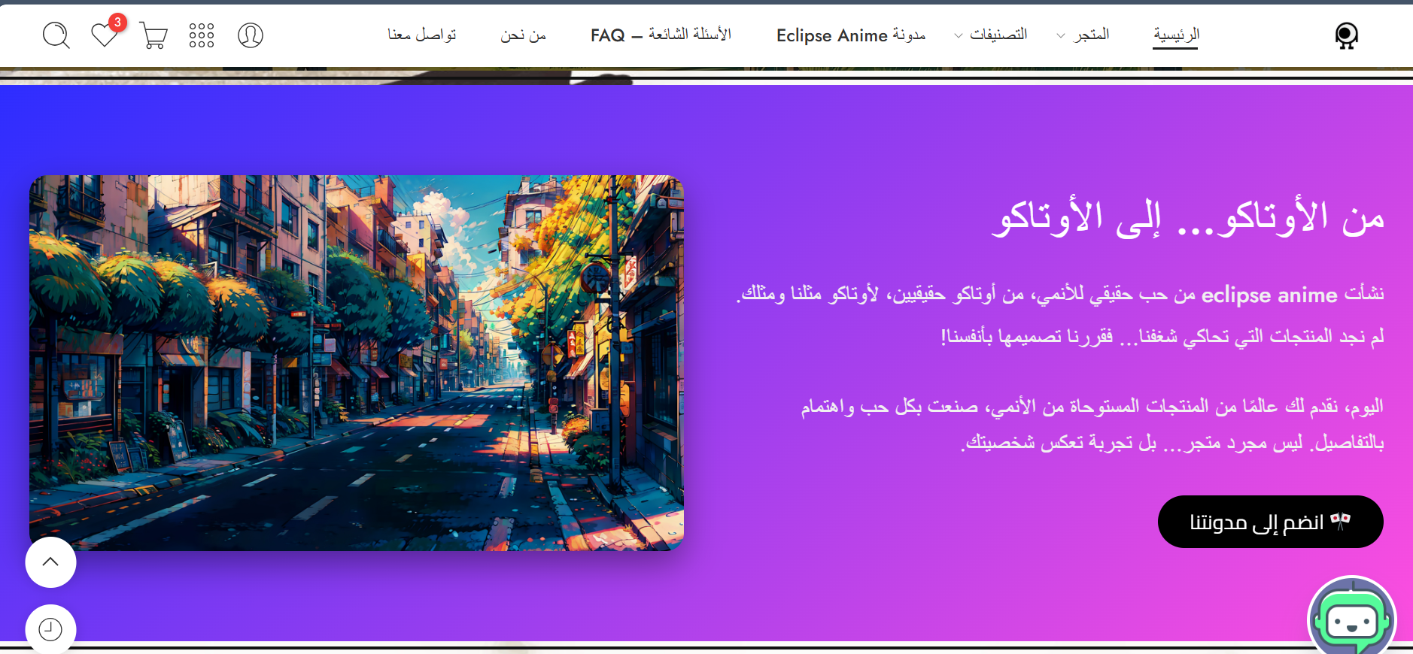
2
System Design
Home Page componants for example:
An-Najah National University – MIS Department

Slide 21
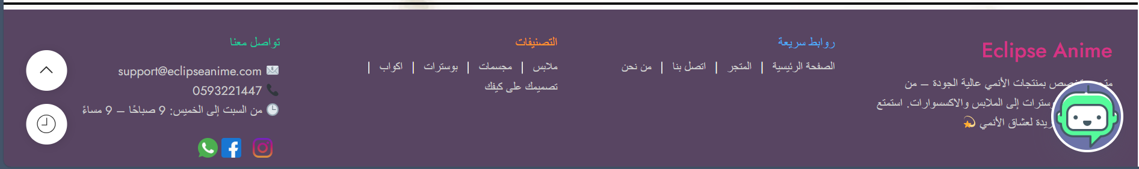
2
System Design
Home Page componants for example:
An-Najah National University – MIS Department

Slide 22
3
Implementation (Coding)
Languages Used:
Plugins Used:
PHP (Backend)
HTML
CSS
JavaScript
MySQL
WooCommerce
myCred
Tidio Chat
Insert PHP Code Snippet
MailPoet
An-Najah National University – MIS Department

Slide 23
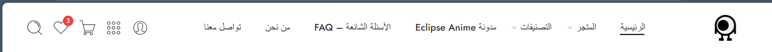
3
Implementation (Coding)
A. Browsing & Interface
Navigation Bar Goal:
Helps users easily navigate between main
sections of the website, ensuring a smooth browsing experience.
An-Najah National University – MIS Department

Slide 24
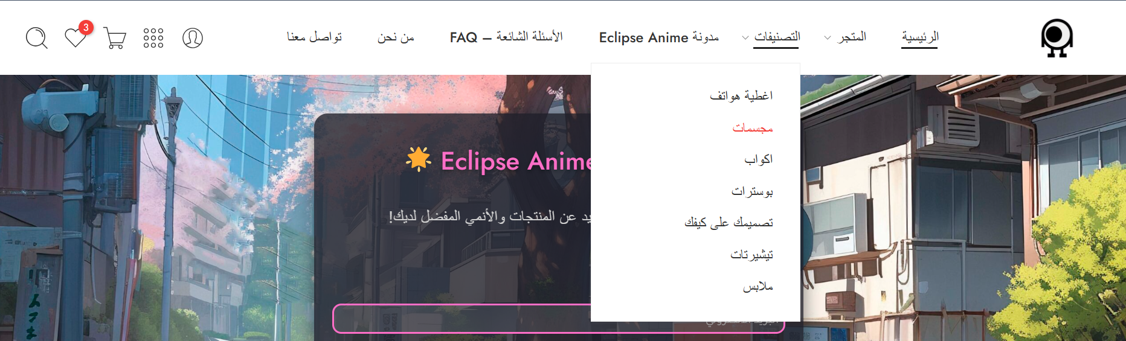
3
Implementation (Coding)
A. Browsing & Interface
2. Product Categories Goal:
Organizes products into clear sections
(e.g., apparel, posters, keychains), making it easier for users to find what they’re looking for.
An-Najah National University – MIS Department

Slide 25
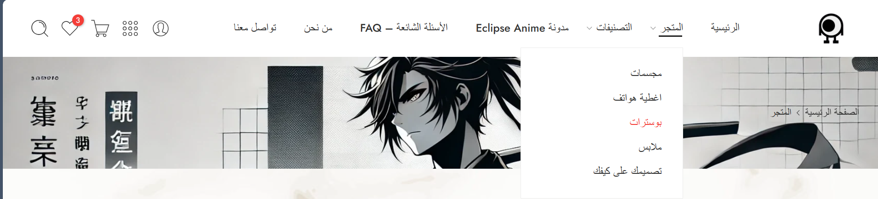
3
Implementation (Coding)
A. Browsing & Interface
2. Product Categories:
An-Najah National University – MIS Department

Slide 26
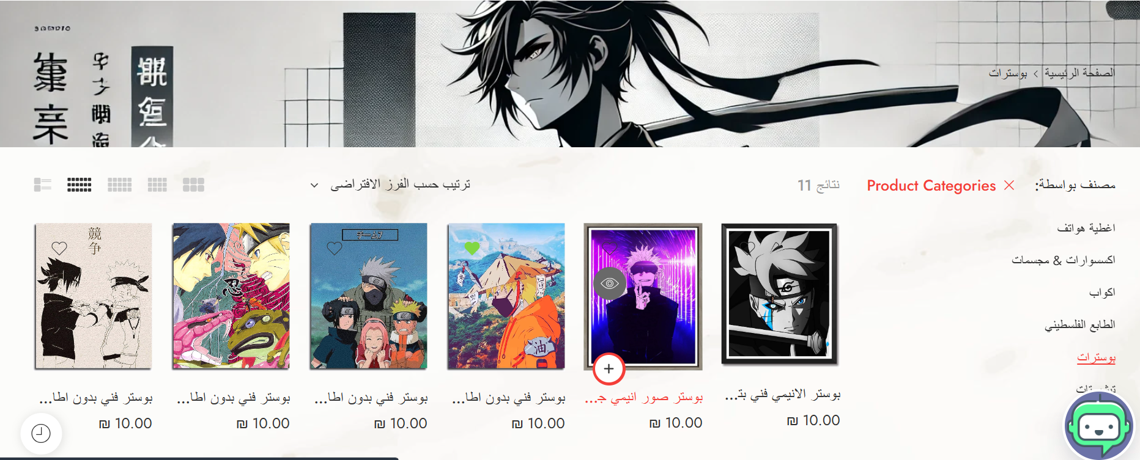
3
Implementation (Coding)
A. Browsing & Interface
2. Product Categories:
An-Najah National University – MIS Department

Slide 27
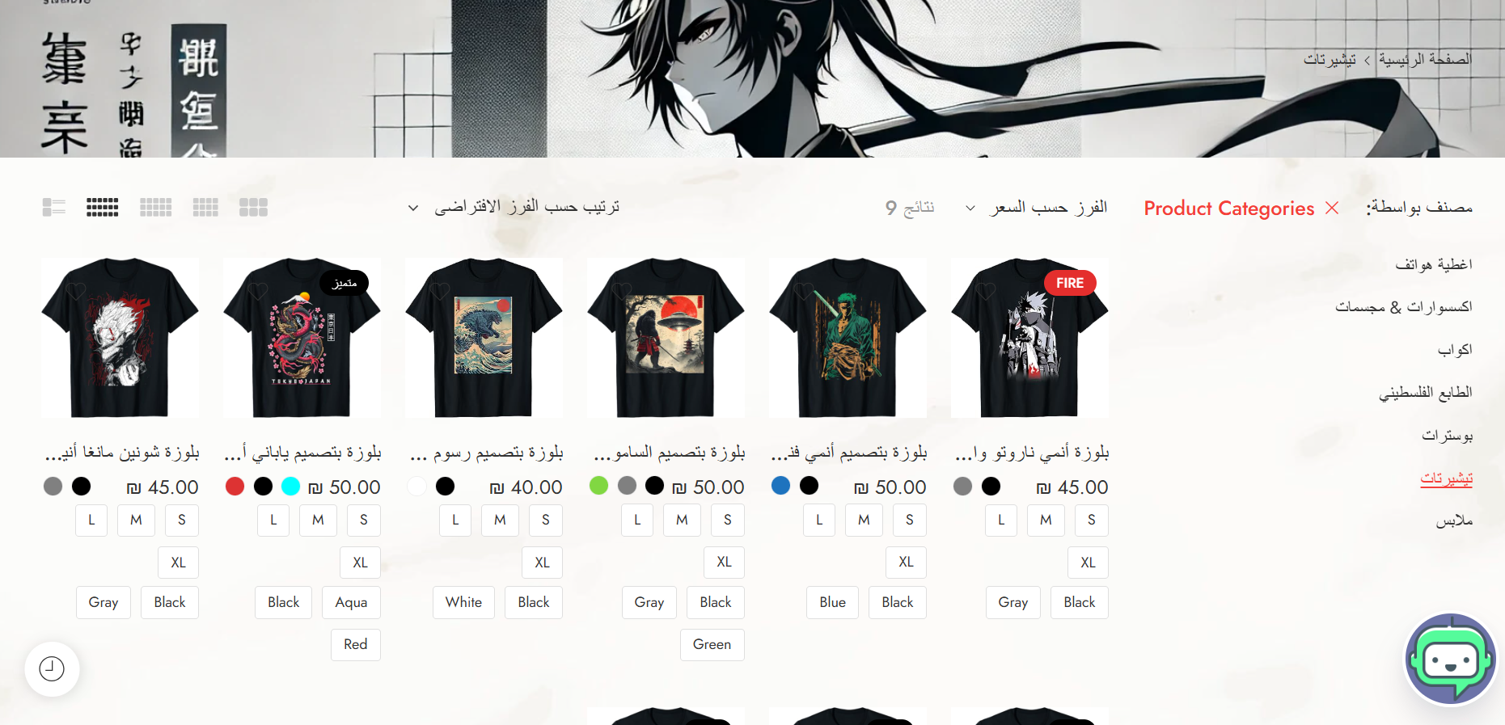
3
Implementation (Coding)
A. Browsing & Interface
2. Product Categories:
An-Najah National University – MIS Department

Slide 28
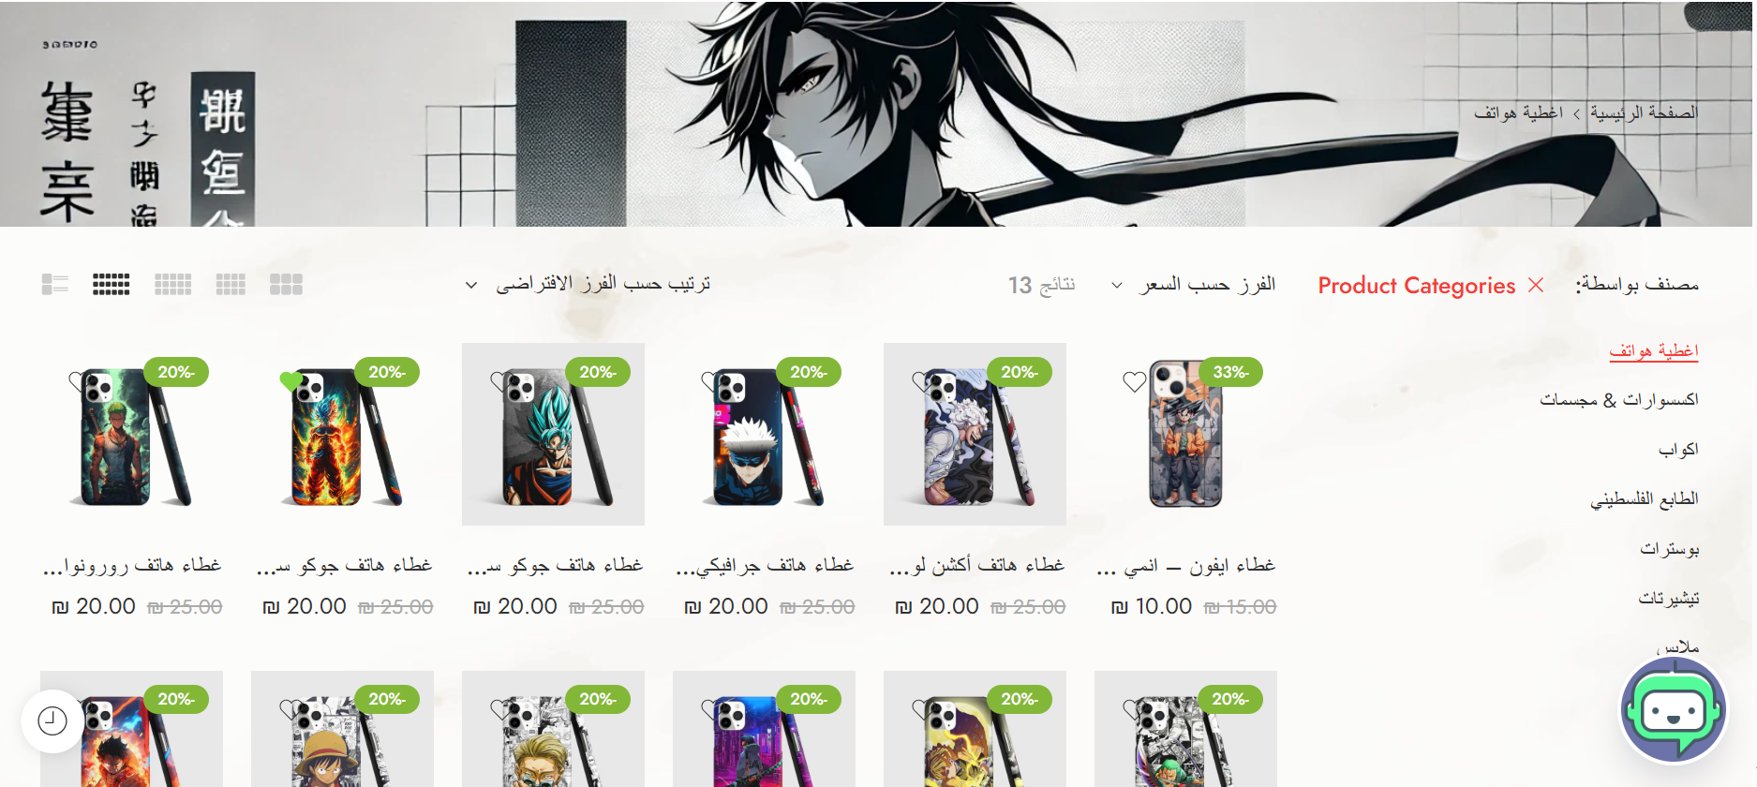
3
Implementation (Coding)
A. Browsing & Interface
2. Product Categories:
An-Najah National University – MIS Department

Slide 29
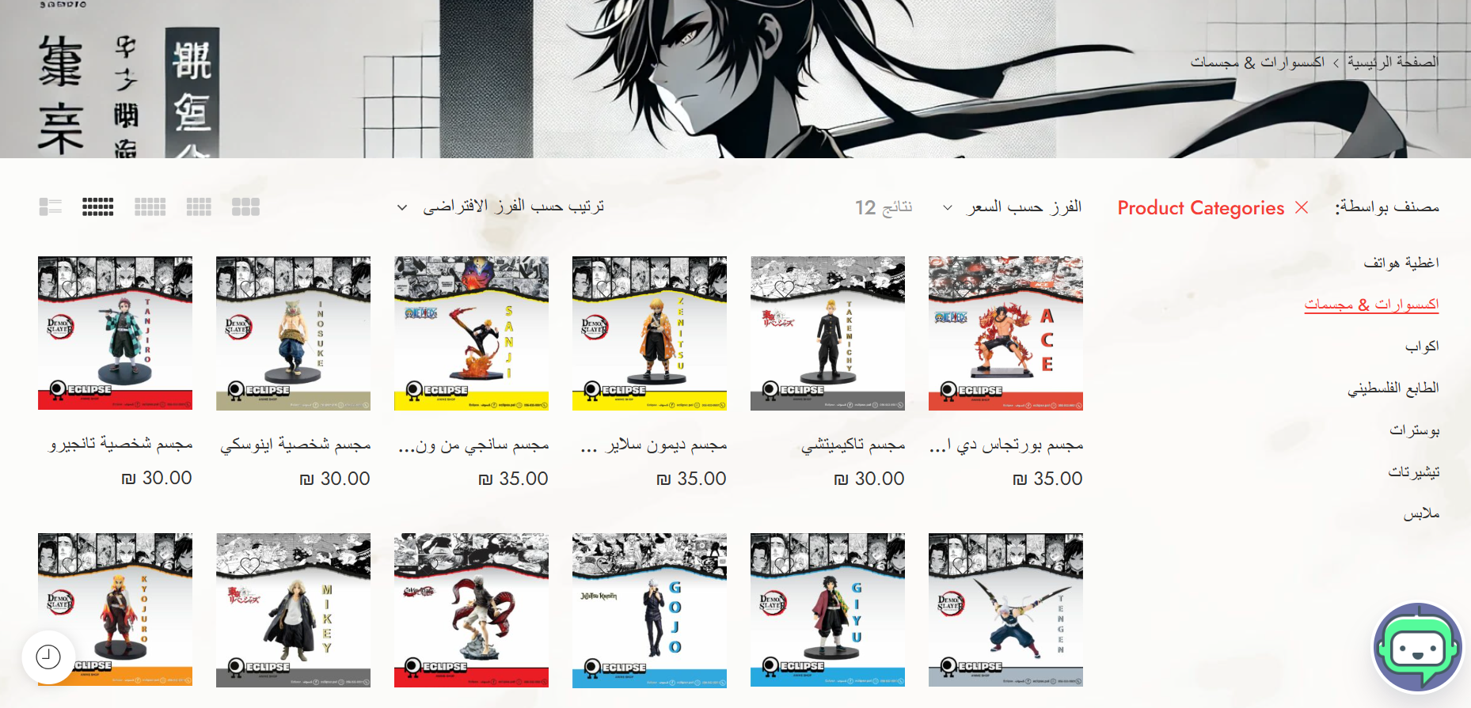
3
Implementation (Coding)
A. Browsing & Interface
2. Product Categories:
An-Najah National University – MIS Department

Slide 30
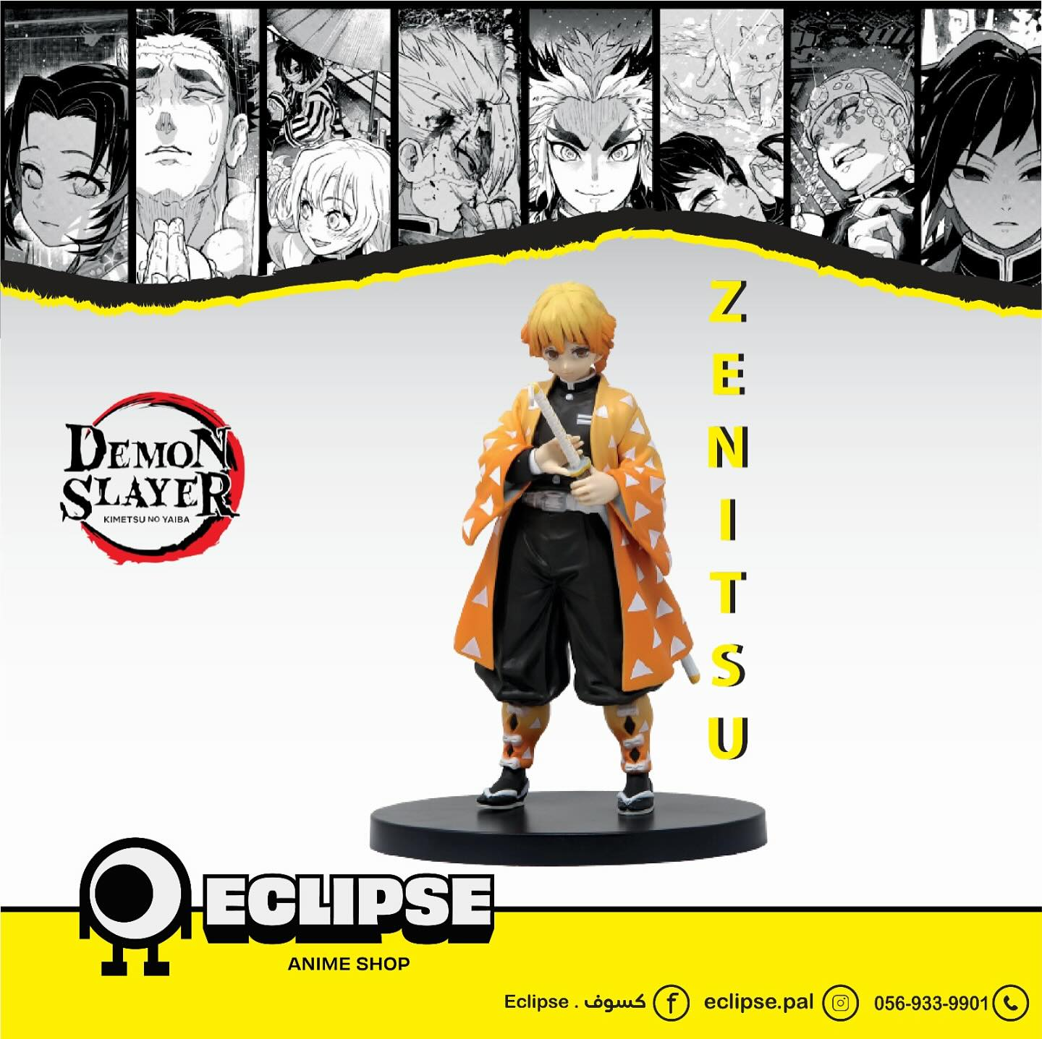
3
Implementation (Coding)
A. Browsing & Interface
2. Product Categories:
We designed the product display layout ourselves, including the background, product arrangement,
and category structure, to match the anime theme and create a fun shopping experience.
An-Najah National University – MIS Department

Slide 31
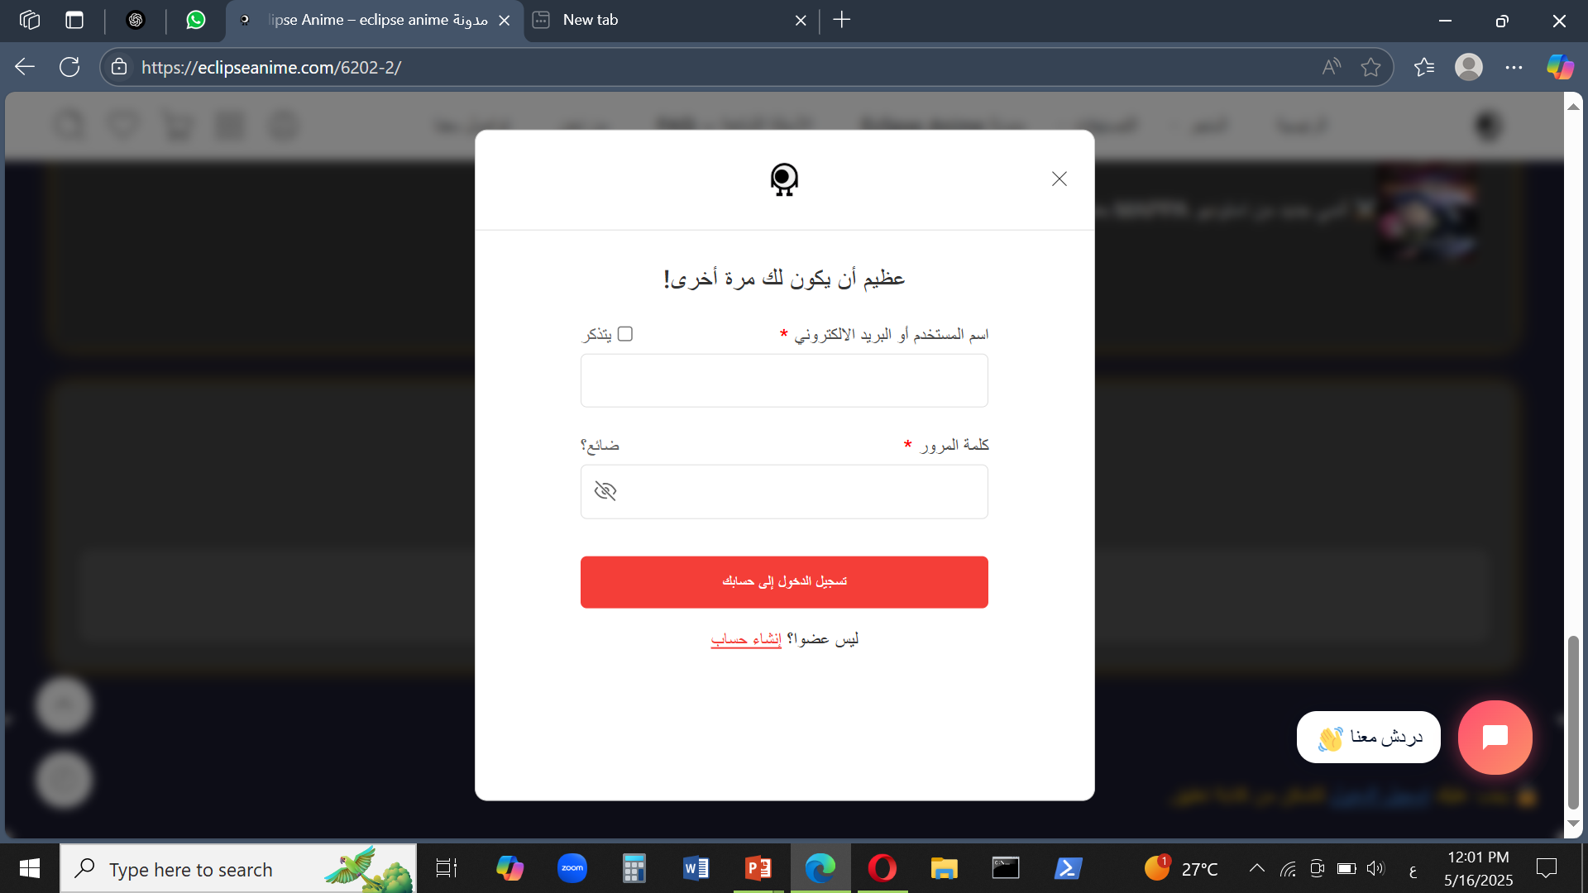
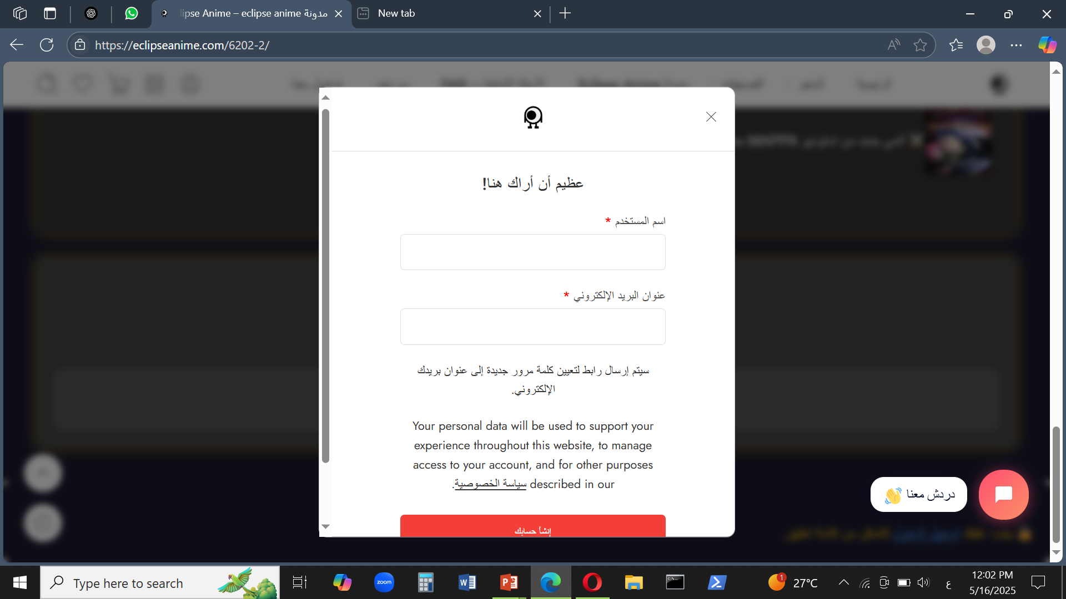
3
Implementation (Coding)
B. Account & Interaction
1. Sign Up / Login Page:
Enables users to create accounts, track orders, and save favorites.
An-Najah National University – MIS Department

Slide 32
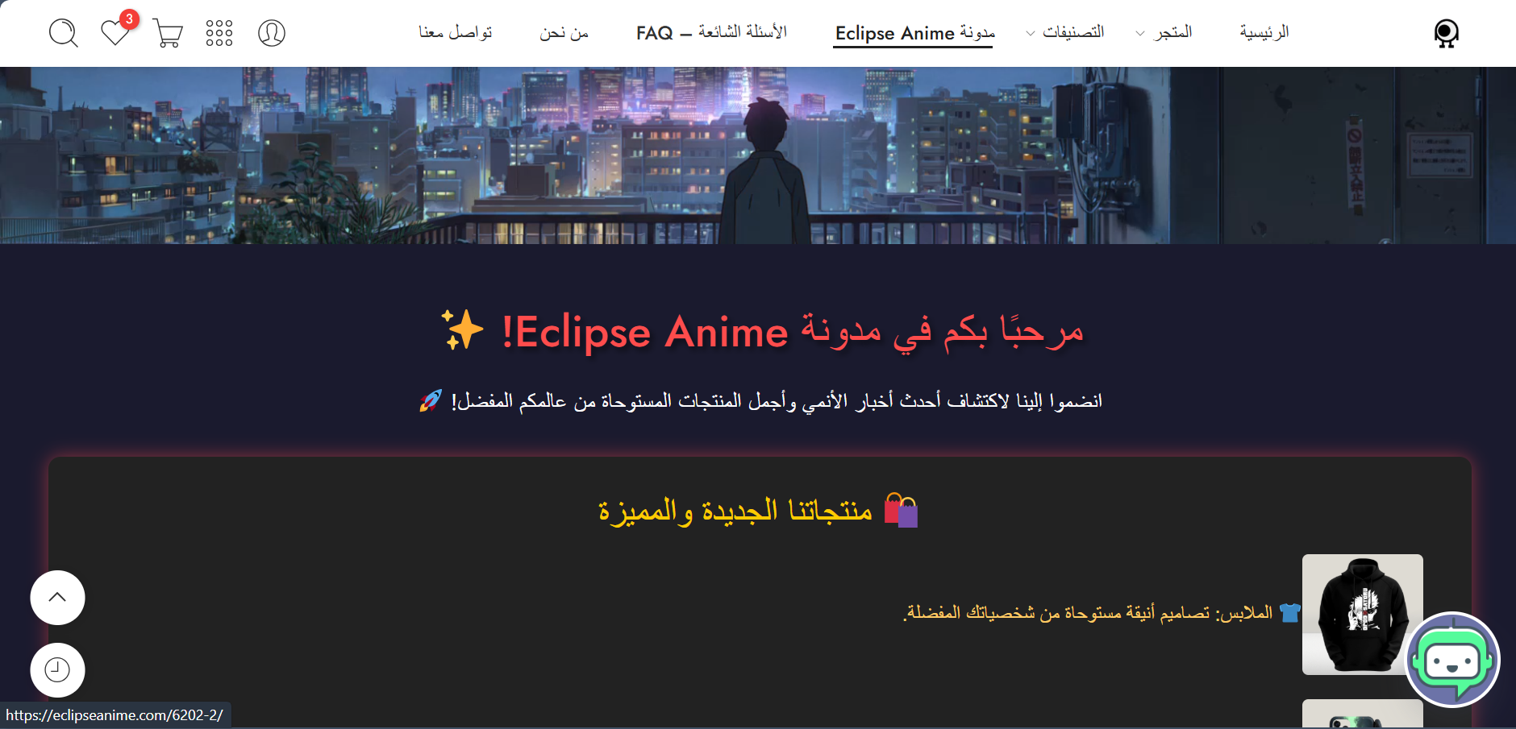
3
Implementation (Coding)
B. Account & Interaction
3. Blog Page Goal:
Offers anime-related articles and content to keep users engaged and build a loyal fan base beyond shopping.
An-Najah National University – MIS Department

Slide 33
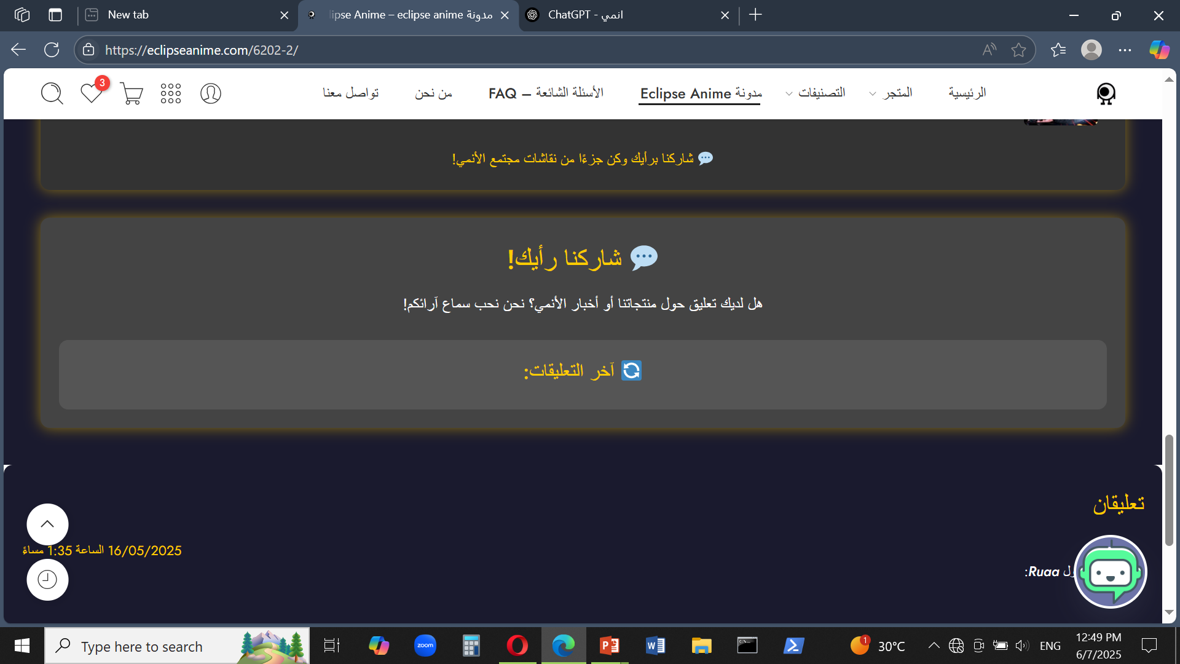
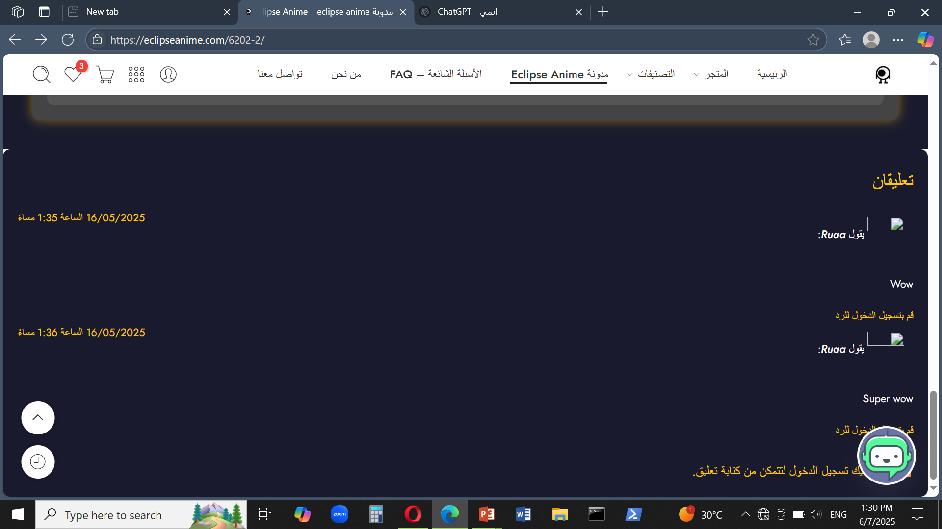
3
Implementation (Coding)
B. Account & Interaction
2. Comment on Blog:
Visitors can share feedback or interact with blog content publicly.
An-Najah National University – MIS Department

Slide 34

3
Implementation (Coding)
B. Account & Interaction
3. Comment Moderation System
To maintain content quality and prevent spam, all comments go through manual moderation.
Users see a message indicating their comment is pending, and we approve it only after review.
An-Najah National University – MIS Department

Slide 35
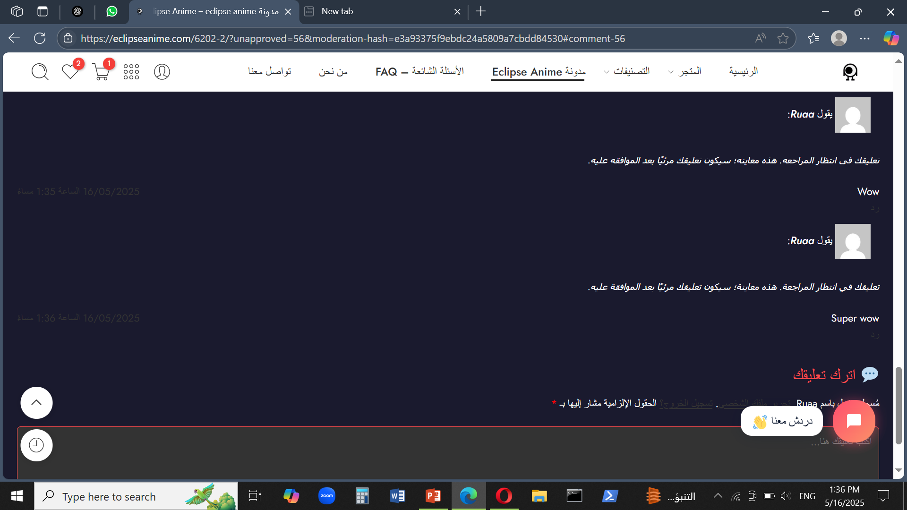
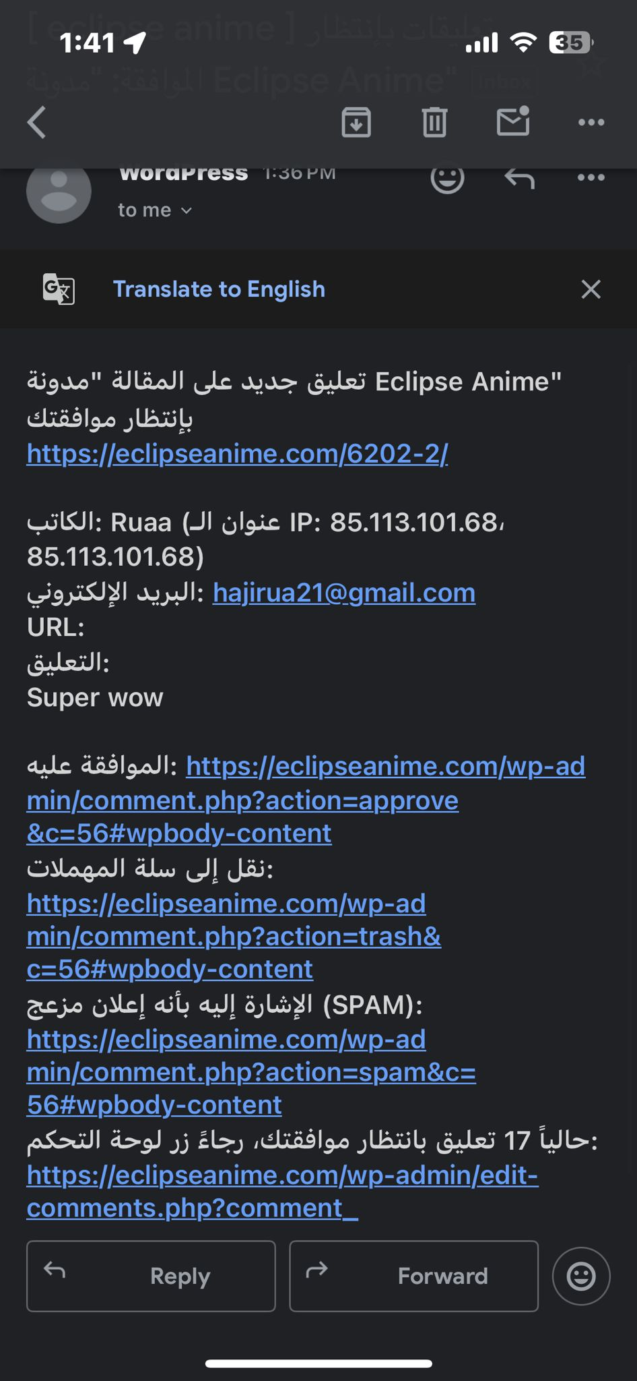


3
Implementation (Coding)
B. Account & Interaction
3. Comment Moderation System
An-Najah National University – MIS Department

Slide 36


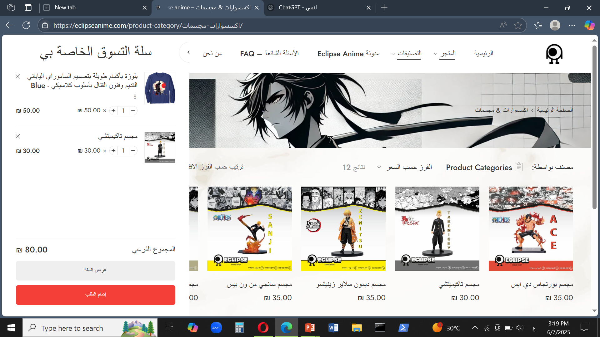
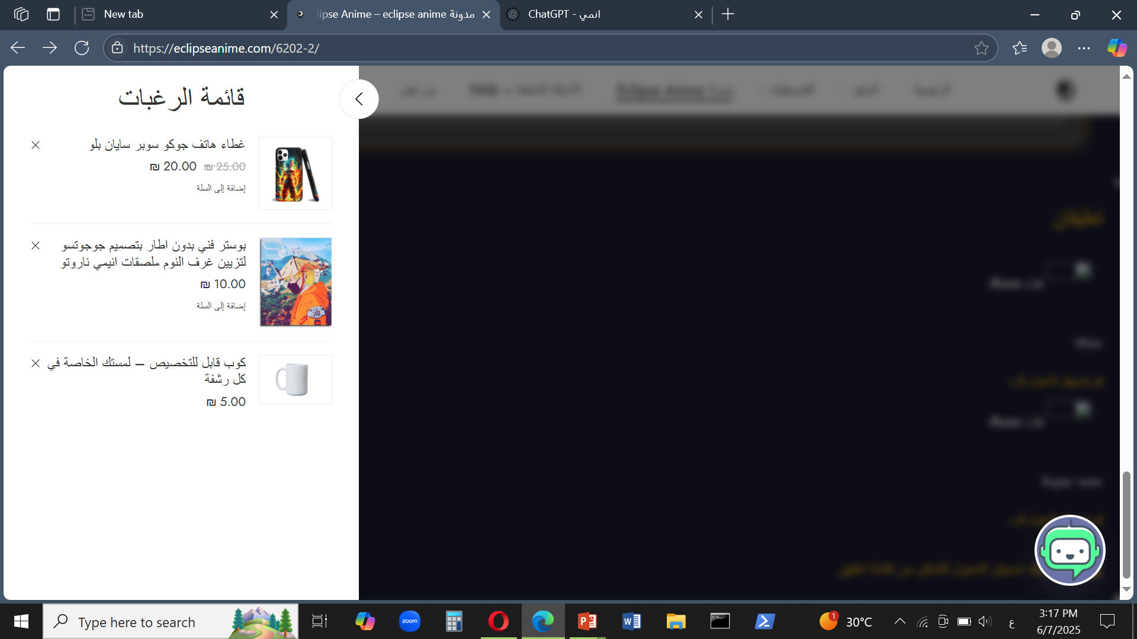
3
Implementation (Coding)
B. Account & Interaction
4. Buyer Features:
Shopping Cart
Favorites
Enhance of the shopping
experience and
decision-making.
An-Najah National University – MIS Department

Slide 37
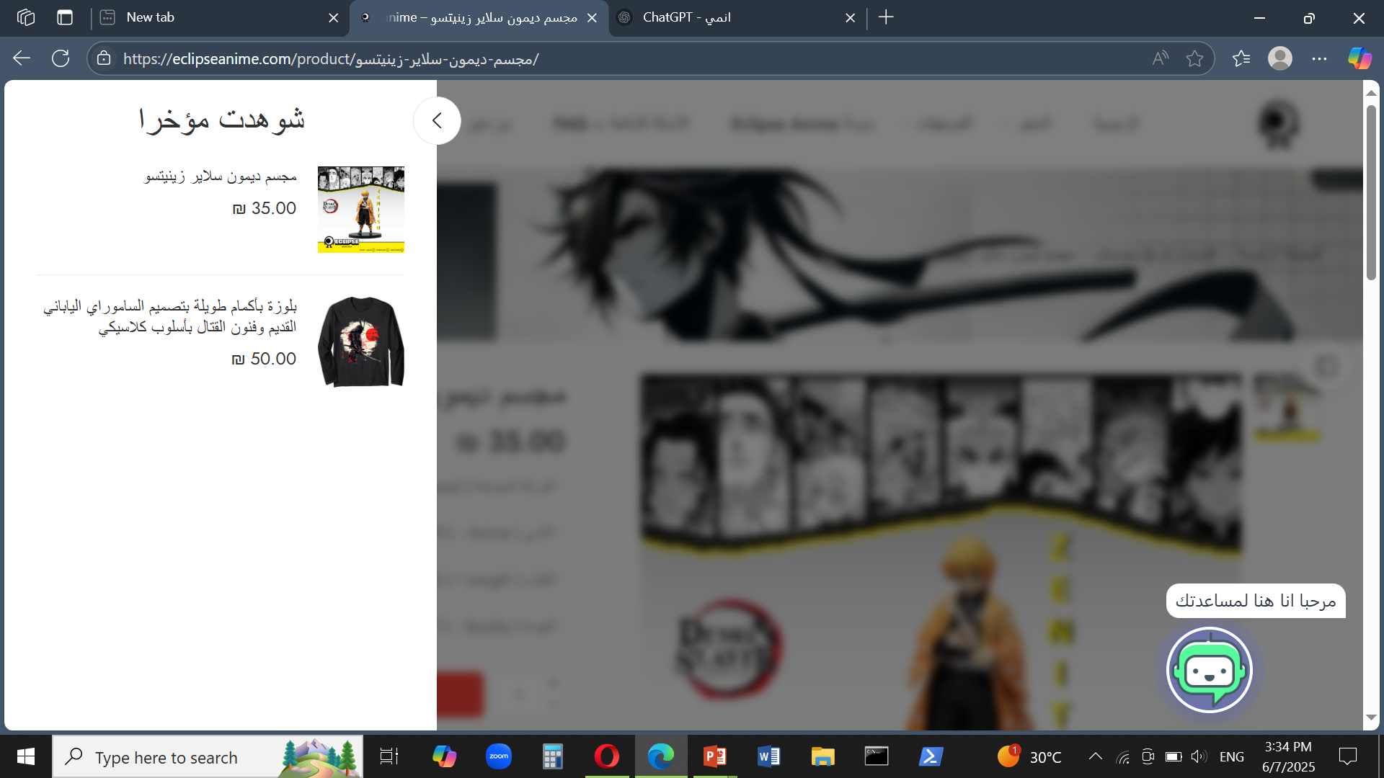
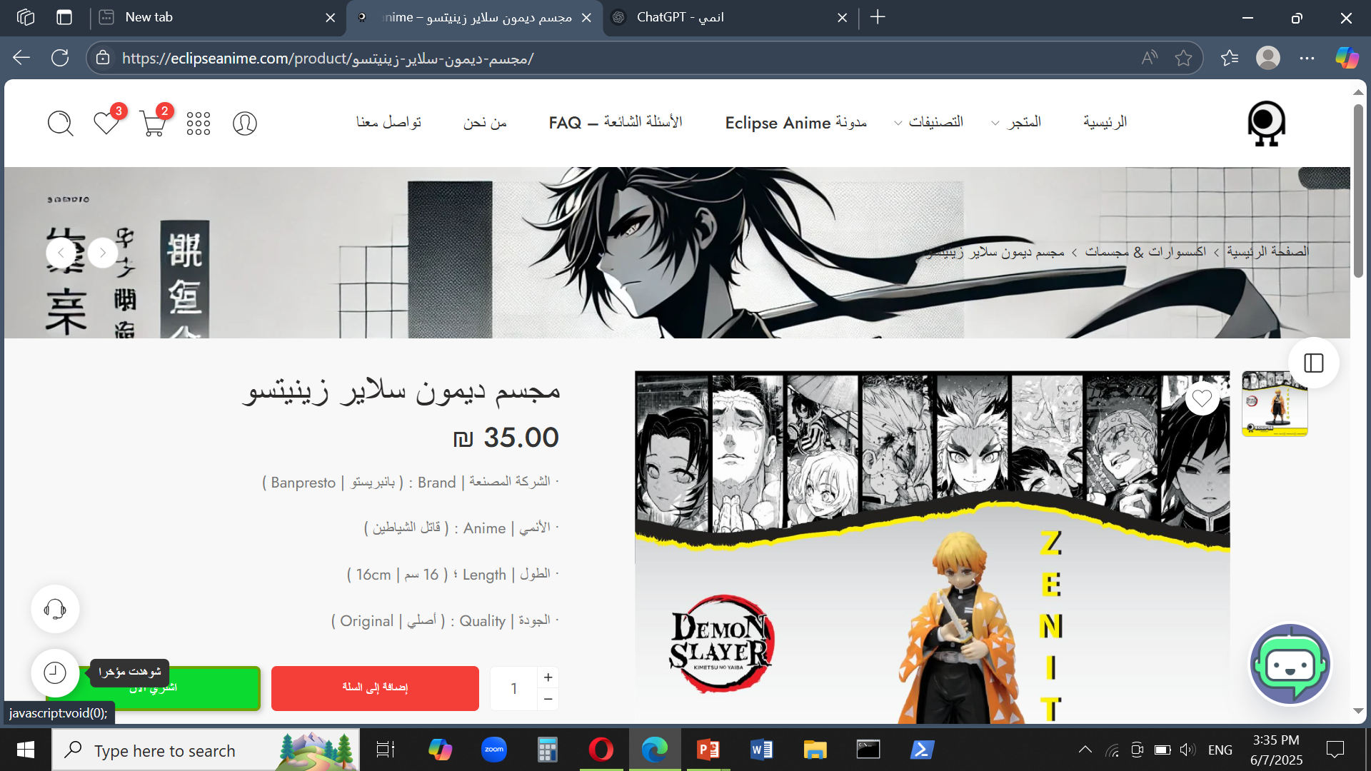
3
Implementation (Coding)
B. Account & Interaction
4. Buyer Features:
Helps users quickly revisit products they viewed. Improves shopping experience and saves time. Encourages decision-making and purchases.
Recently Viewed
Items:
An-Najah National University – MIS Department

Slide 38
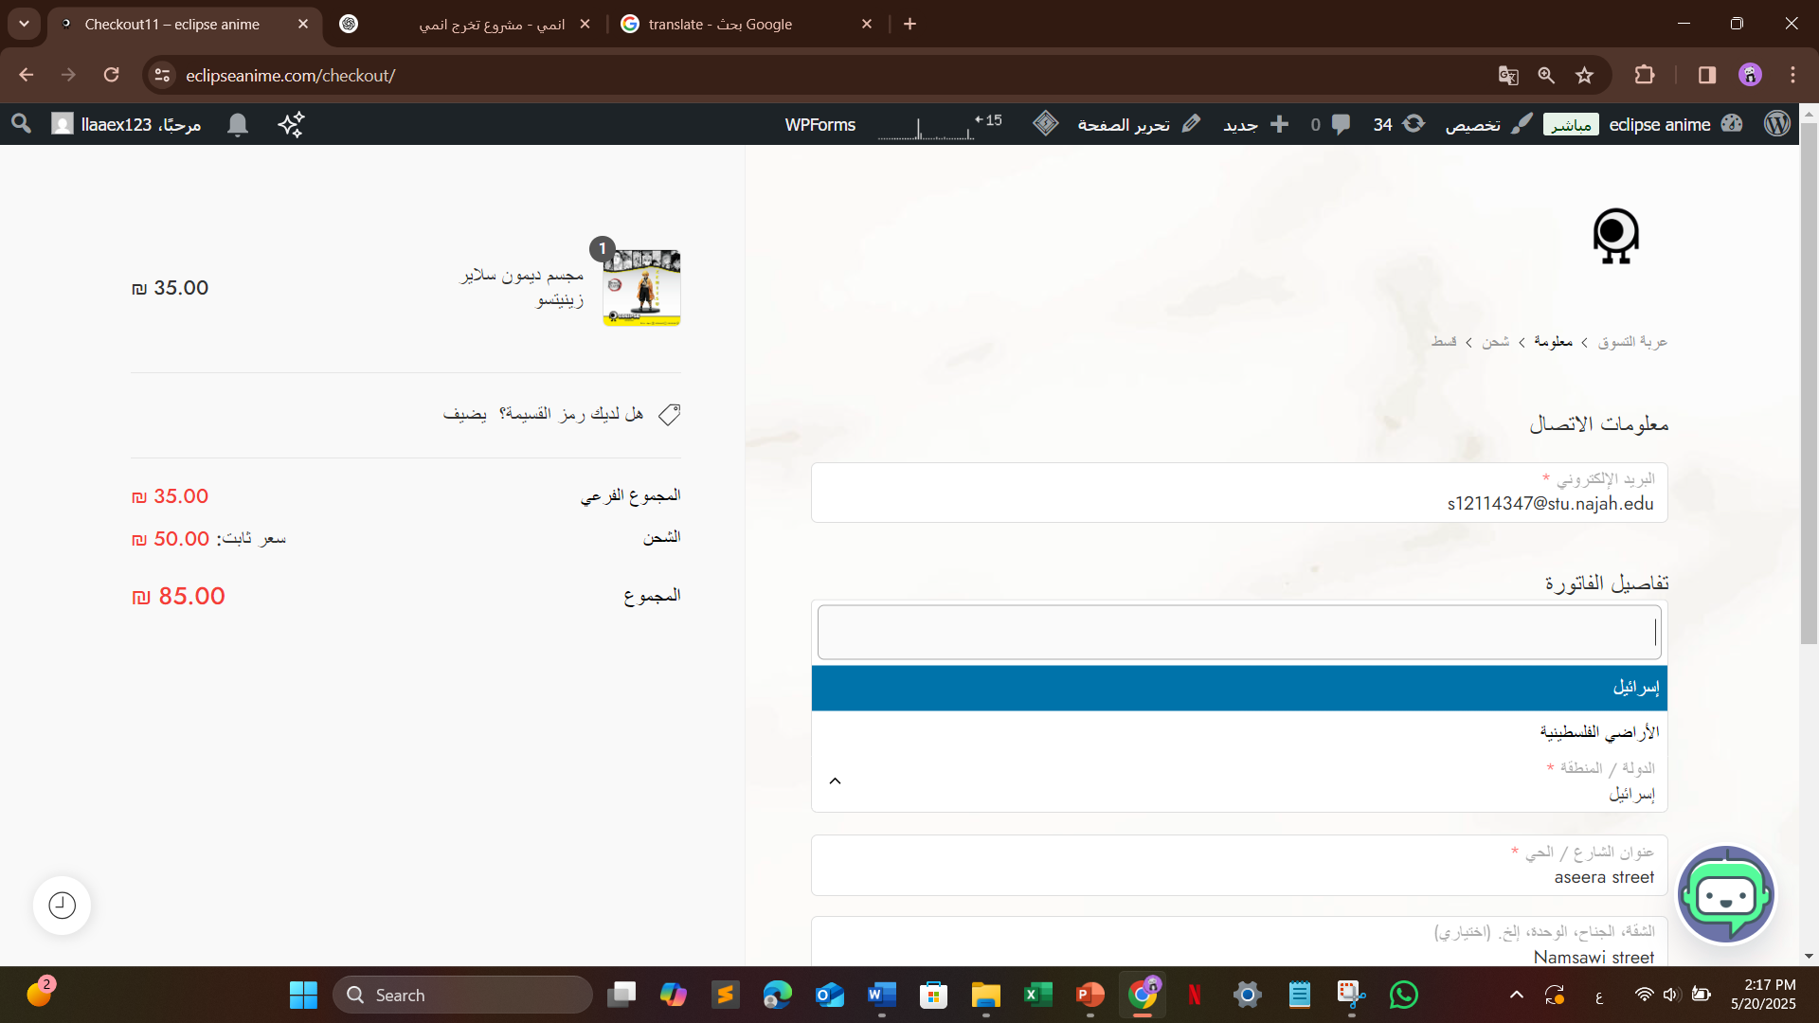
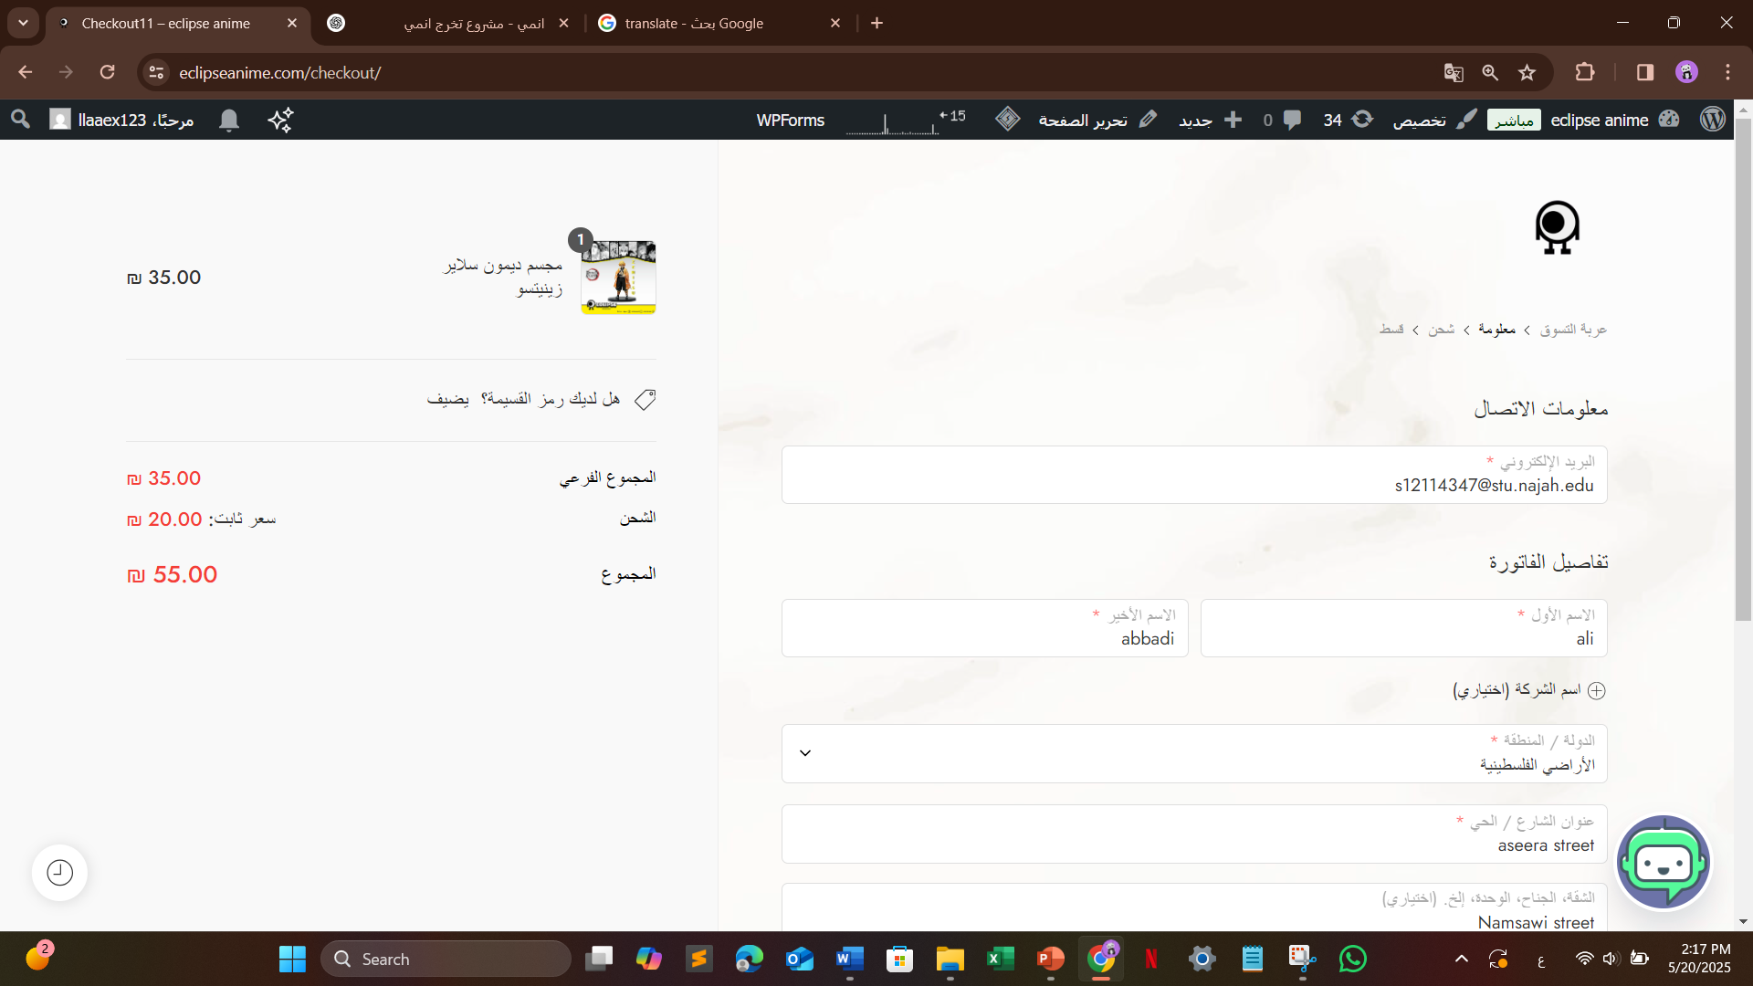

3
Implementation (Coding)
B. Account & Interaction
5. Dynamic Shipping-Based Pricing:
The product price updates based on the selected shipping location.
This helps provide accurate total costs before checkout, ensuring transparency and improving user trust.
1948 Areas
West Bank
Shipping cost is added based on location to reflect real delivery fees.
An-Najah National University – MIS Department

Slide 39
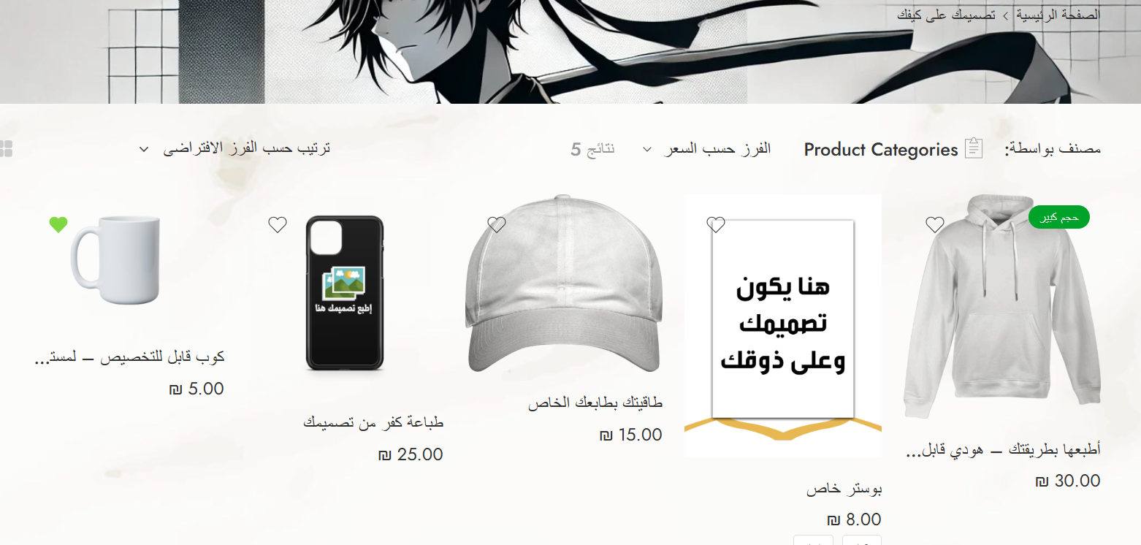
3
Implementation (Coding)
B. Account & Interaction
5. Advanced Product Customization – Step by Step:
In this feature, users can choose a product and fully customize it by
adding images or text.
Each element updates the price automatically based on selections.
They can adjust size, color, position, and even design the front or back of the item.
Available Customizable Products
An-Najah National University – MIS Department

Slide 40
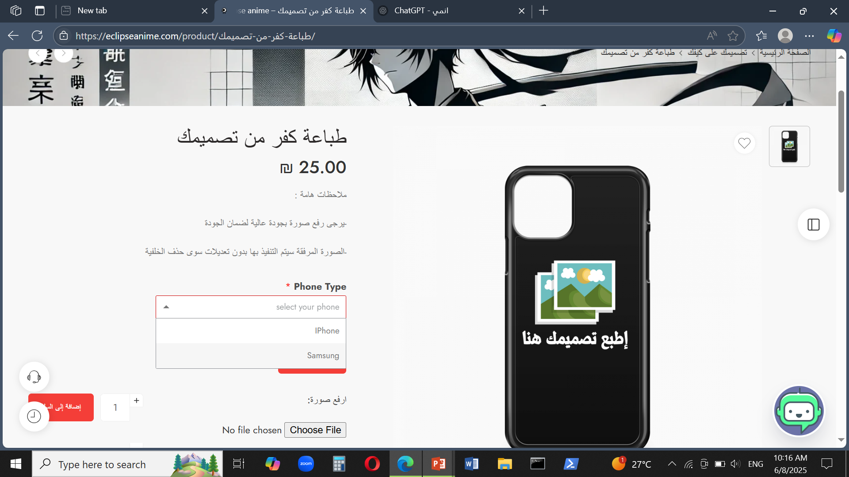
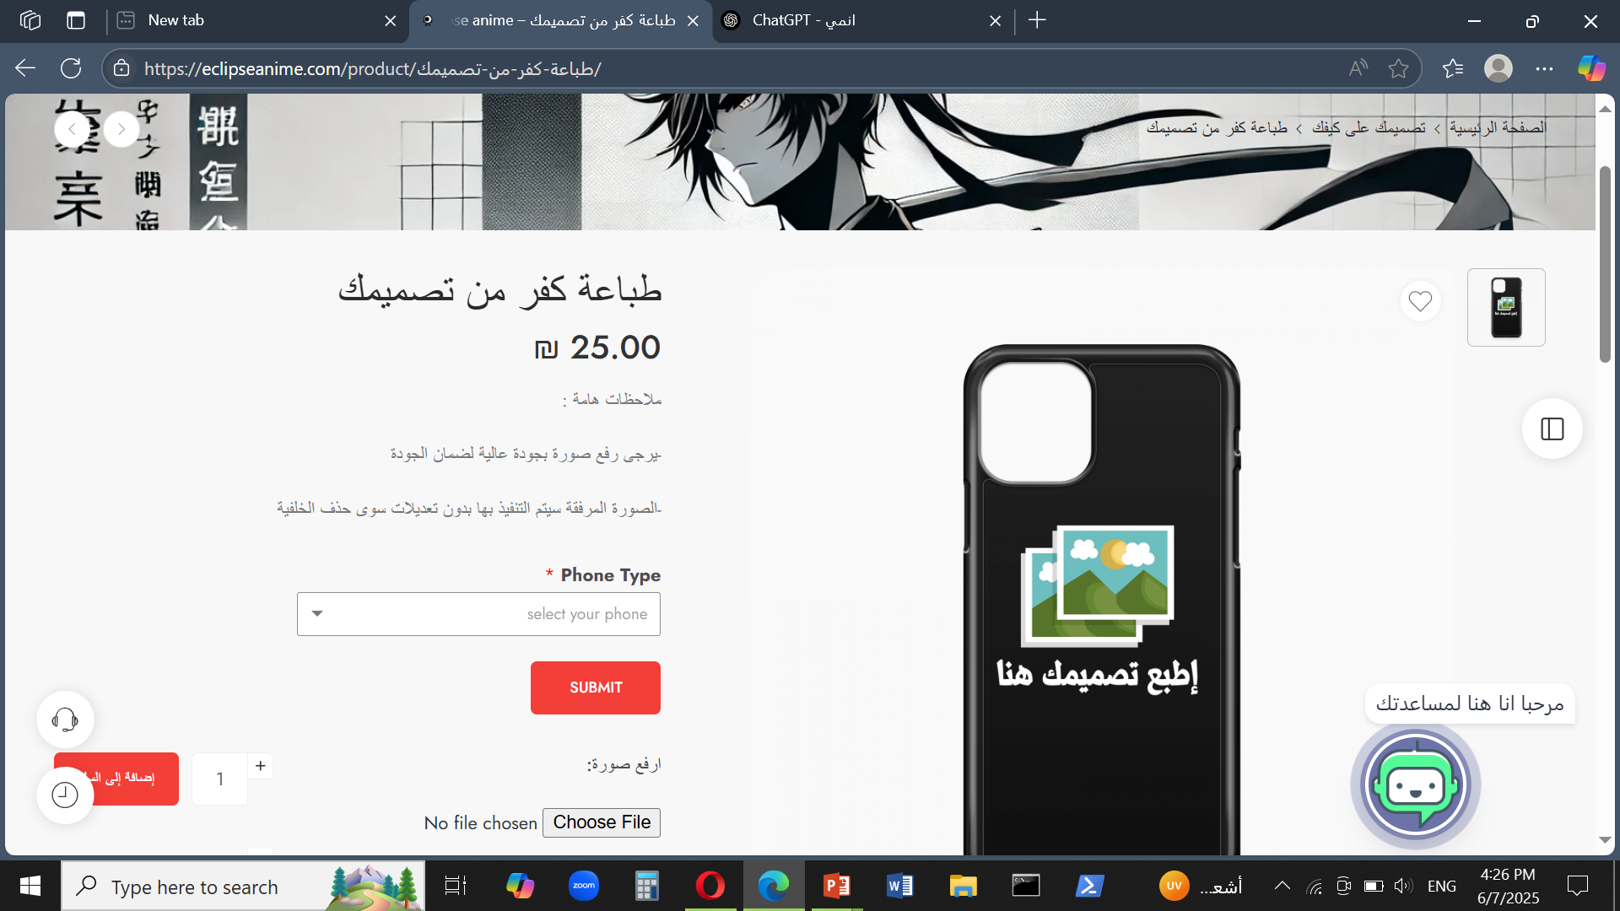
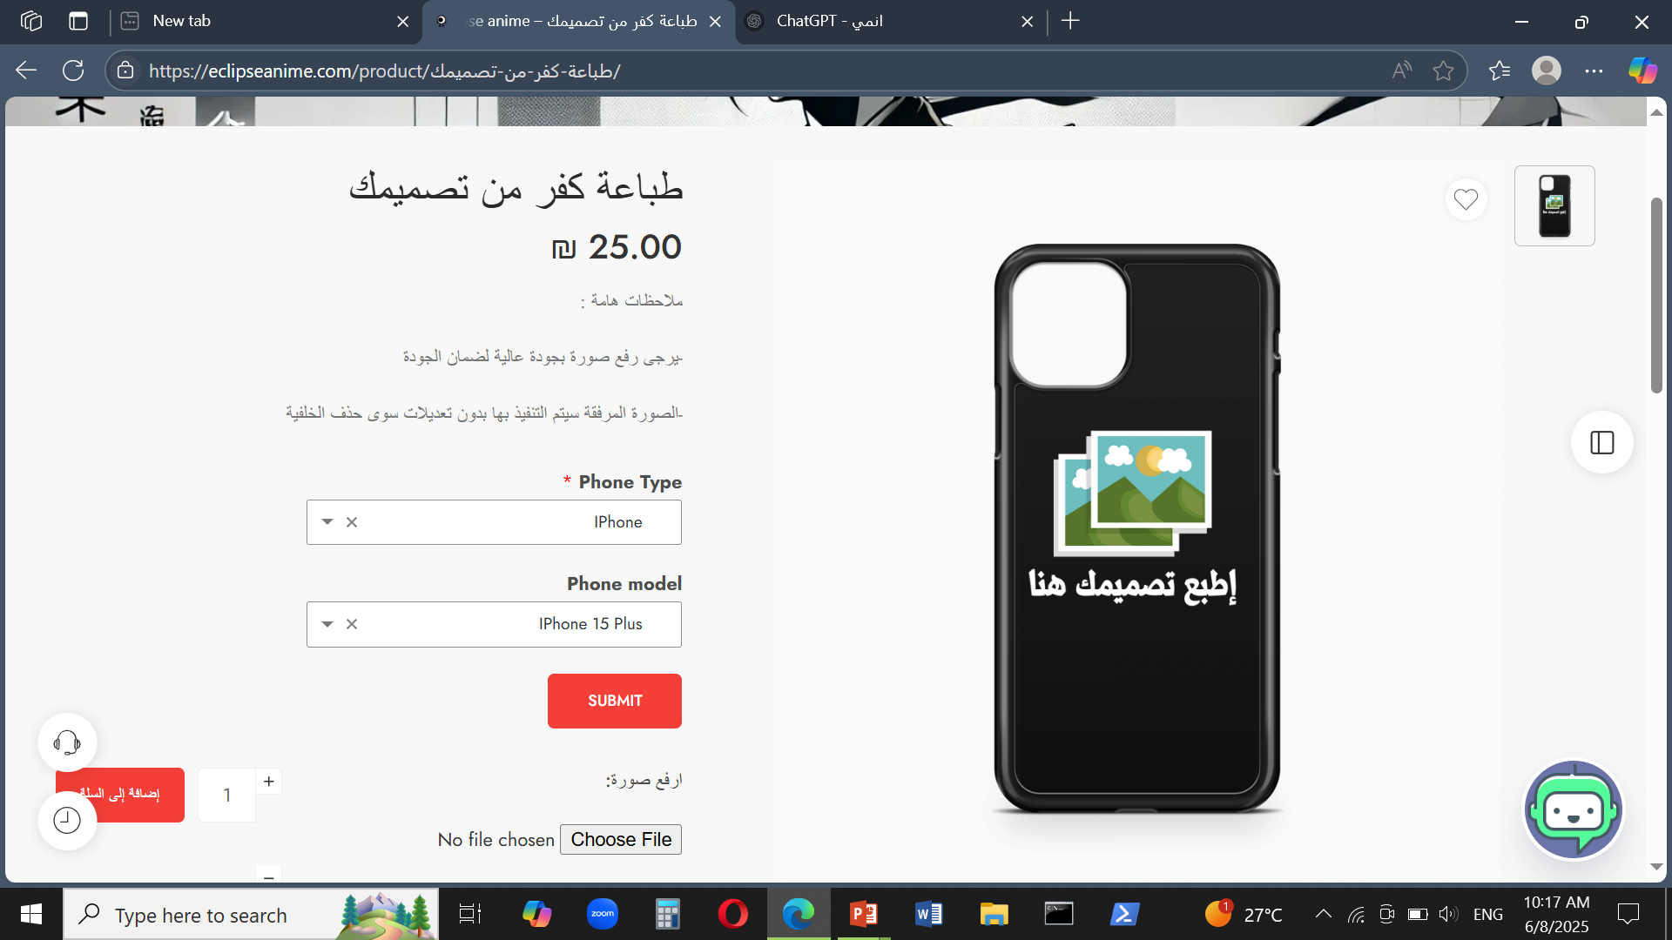
3
Implementation (Coding)
B. Account & Interaction
5. Advanced Product Customization – Step by Step:
Step completed: Product type and device model selected.
An-Najah National University – MIS Department

Slide 41
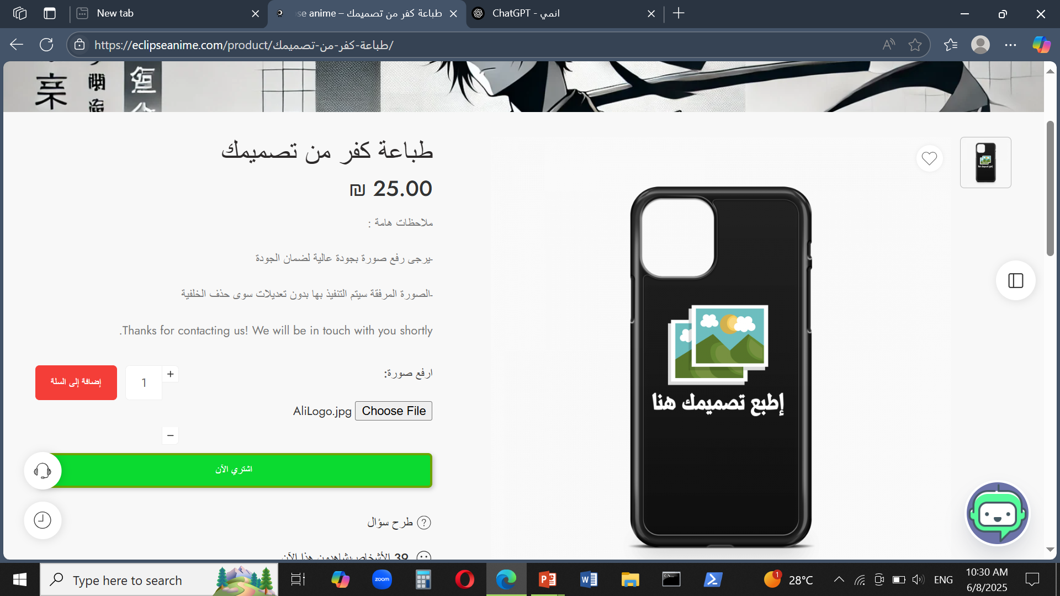
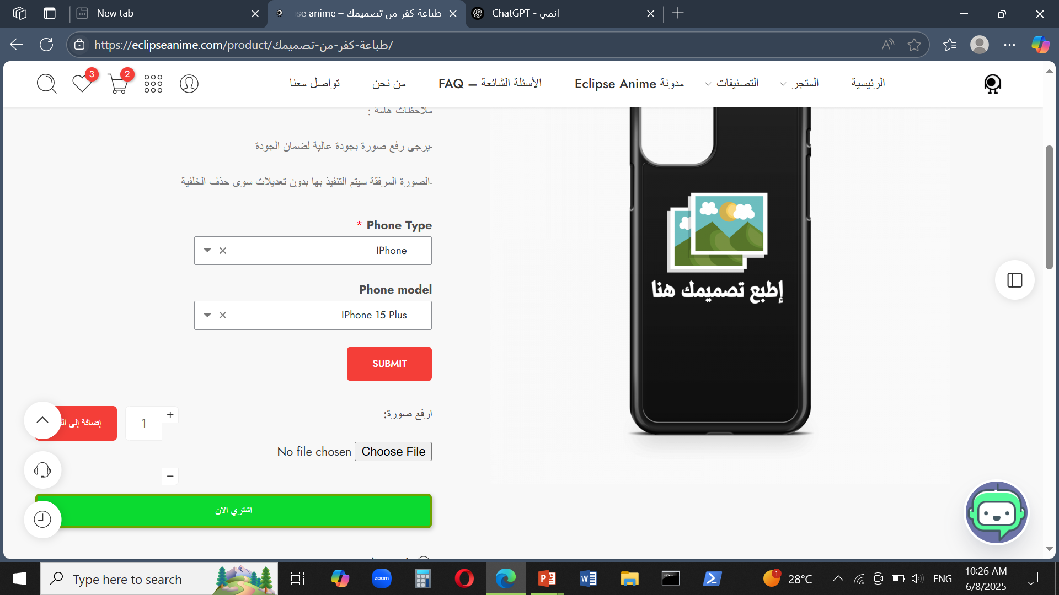
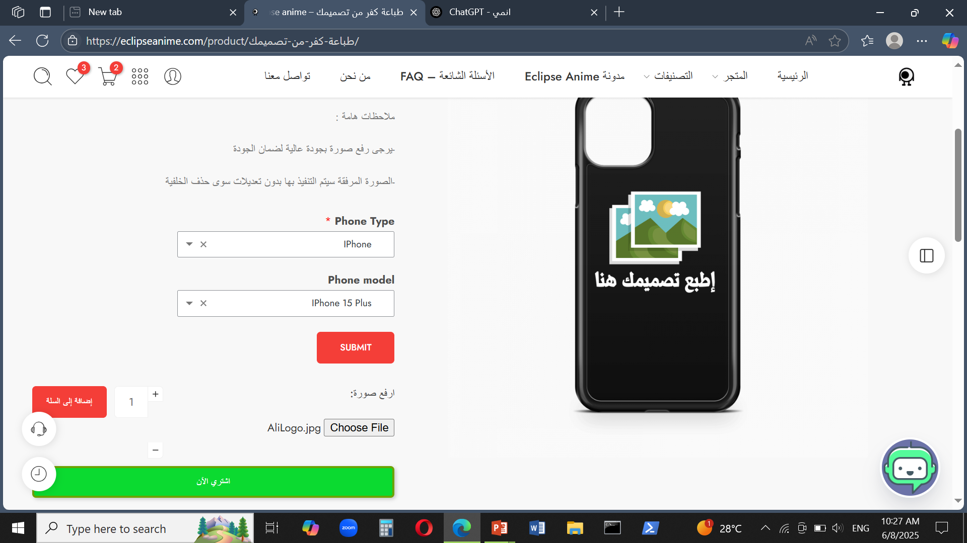
3
Implementation (Coding)
B. Account & Interaction
5. Advanced Product Customization – Step by Step:
Important notes were submitted to the customer:
use high-quality image, background will be removed only.
Step completed: Customer uploaded an image.
An-Najah National University – MIS Department

Slide 42
3
Implementation (Coding)
B. Account & Interaction
5. Advanced Product Customization – Step by Step:
1
2
Ready to buy: From Step 1 or Step 2.
An-Najah National University – MIS Department

Slide 43
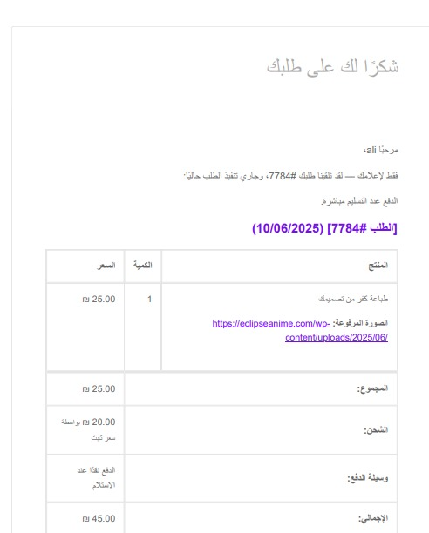
3
Implementation (Coding)
B. Account & Interaction
5. Advanced Product Customization – Step by Step:
Step completed: Email received with content to print.
An-Najah National University – MIS Department

Slide 44
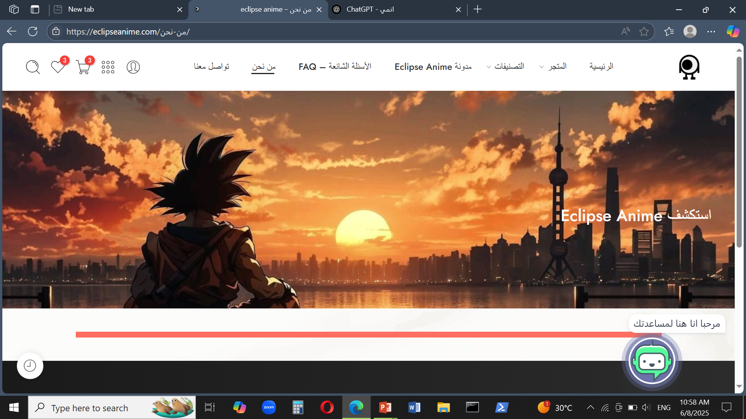
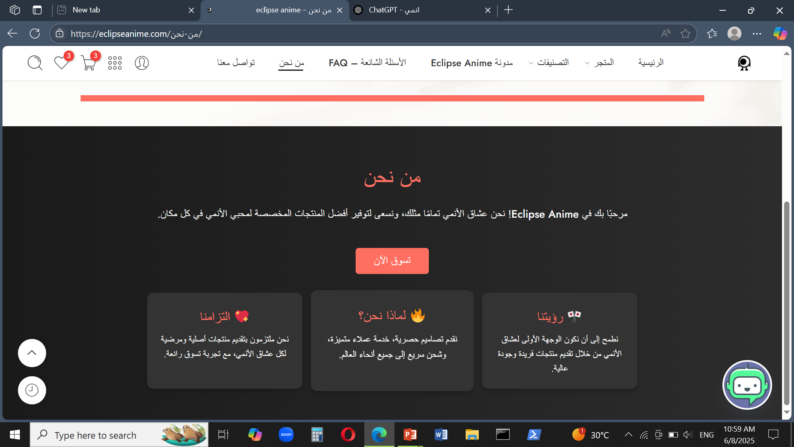
3
Implementation (Coding)
C. Info & Contact Section
1. About Us page:
The About Us page lets users know more about us.
An-Najah National University – MIS Department

Slide 45
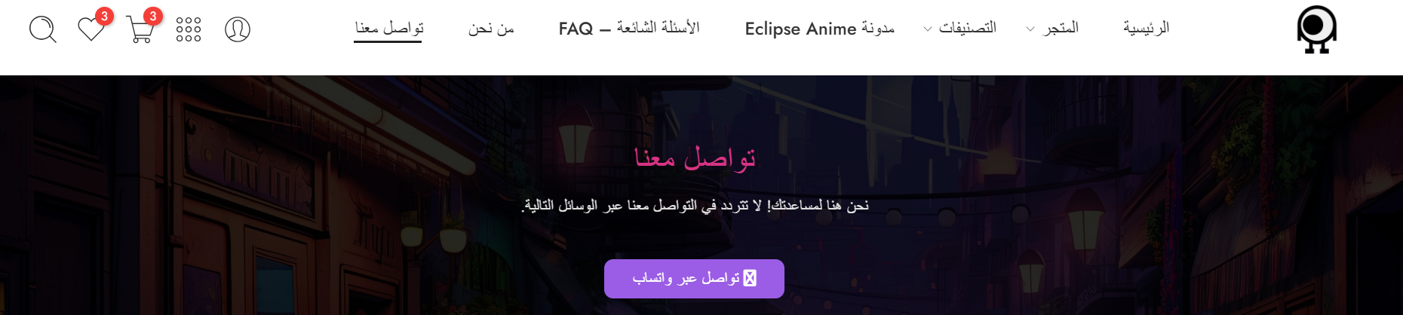
3
Implementation (Coding)
C. Info & Contact Section
2. Contact Us page:
Users can reach us on WhatsApp through the link on the Contact Us page.
An-Najah National University – MIS Department

Slide 46
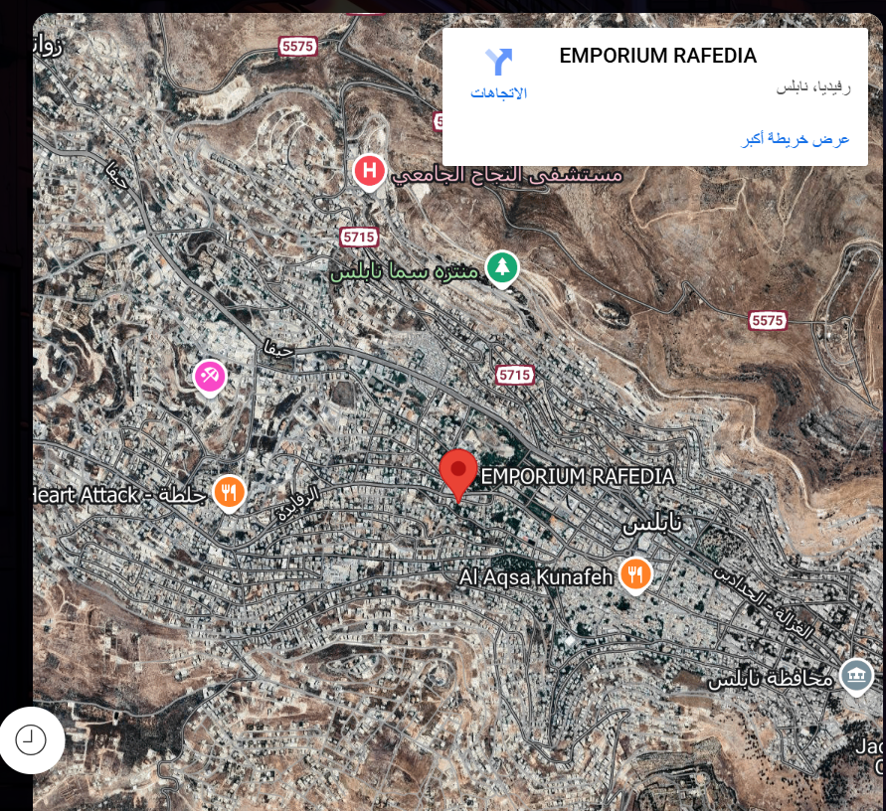
3
Implementation (Coding)
C. Info & Contact Section
2. Contact Us page:
A map was added to show our location and make it easier for users to find us.
An-Najah National University – MIS Department

Slide 47
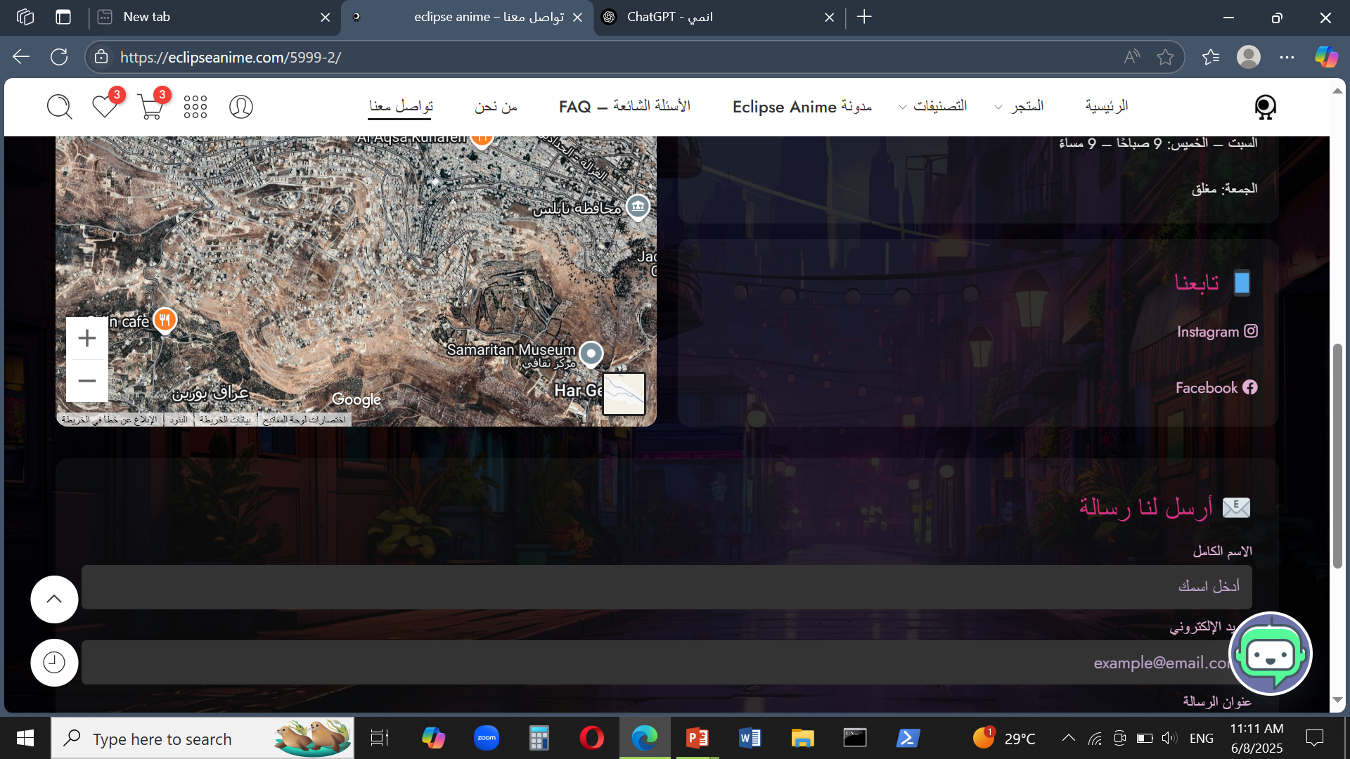
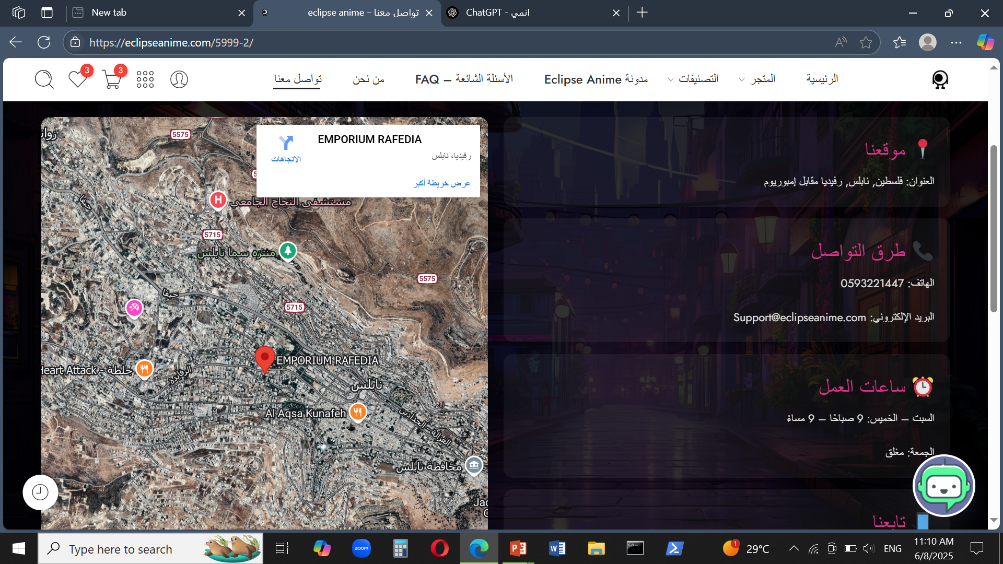
3
Implementation (Coding)
C. Info & Contact Section
2. Contact Us page:
The page includes our location, working hours, social media links, and contact details like email and phone number.
An-Najah National University – MIS Department

Slide 48
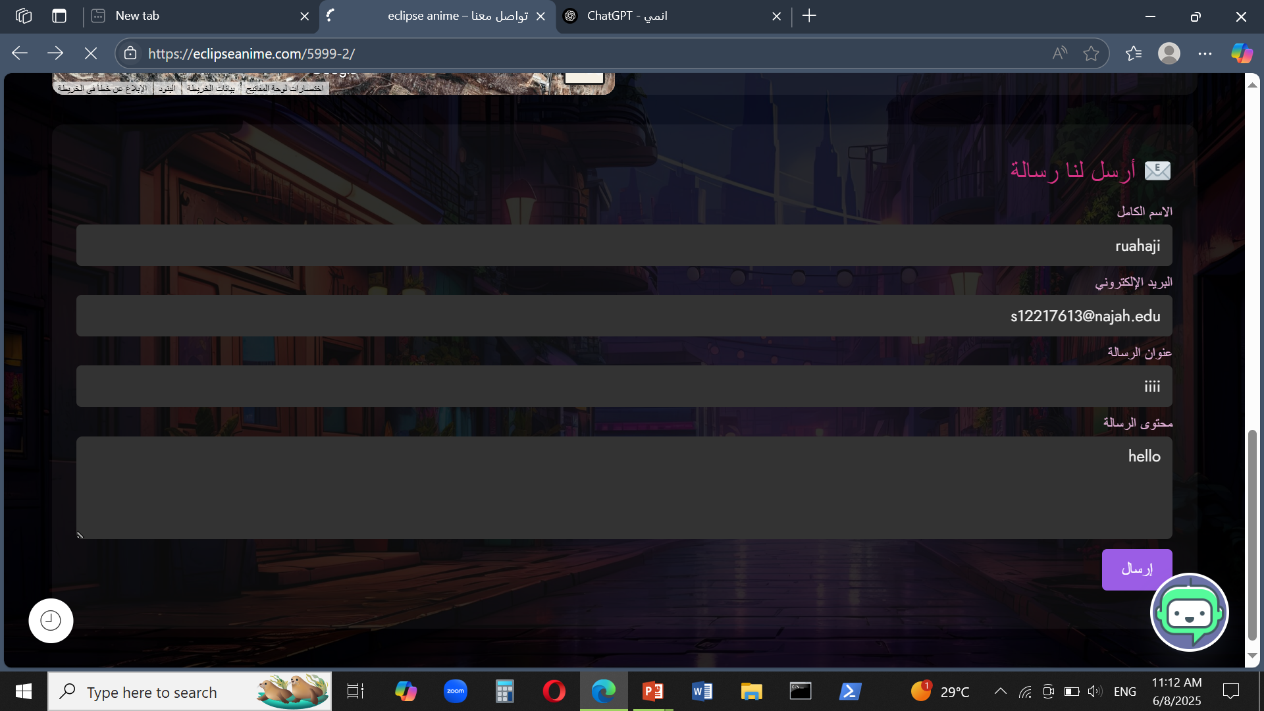
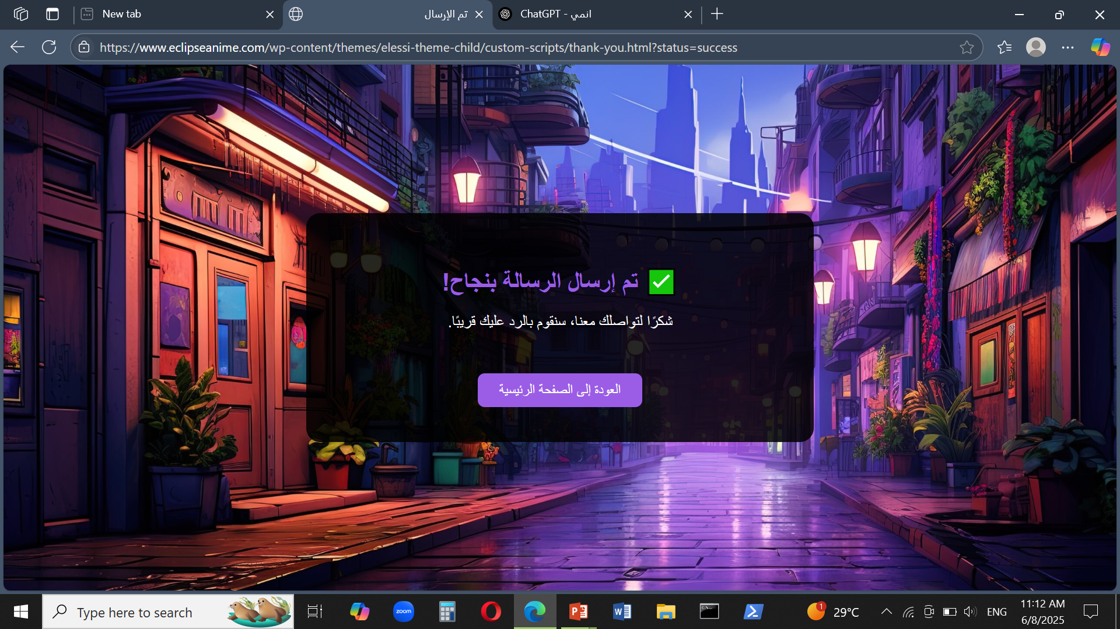
3
Implementation (Coding)
C. Info & Contact Section
2. Contact Us page:
A contact form is available on the page for users who wish to be contacted directly.
An-Najah National University – MIS Department

Slide 49
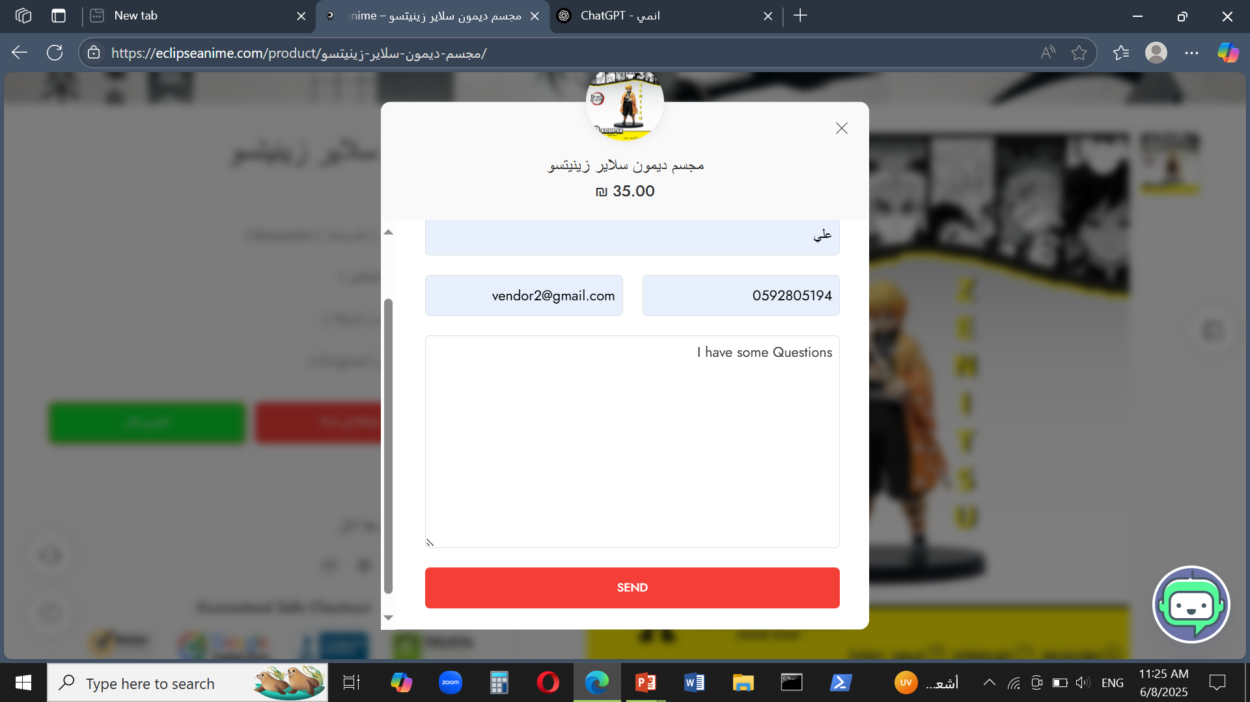


3
Implementation (Coding)
C. Info & Contact Section
3. Ask a Question page:
Users can ask questions via a form on the Product page.
An-Najah National University – MIS Department

Slide 50

3
Implementation (Coding)
C. Info & Contact Section
4. FAQ page:
Helps users find quick answers before contacting support.
An-Najah National University – MIS Department

Slide 51


3
Implementation (Coding)
C. Info & Contact Section
5. Live Chat Icon:
Real-time support for any questions or concerns during the visit.
An-Najah National University – MIS Department

Slide 52
3
Implementation (Coding)
D. Marketing & Promotion Features
We added marketing tools like discounts and subscriptions to support product promotion.
To boost product visibility, attract users, and encourage repeat purchases.
An-Najah National University – MIS Department

Slide 53

3
Implementation (Coding)
D. Marketing & Promotion Features
Email Subscription Flow:
Newsletter Subscription – Step by Step
No login needed — users can subscribe to emails about new arrivals, helping engage first-time visitors.
An-Najah National University – MIS Department

Slide 54

3
Implementation (Coding)
D. Marketing & Promotion Features
Email Subscription Flow:
Newsletter Subscription – Step by Step
After entering their email, users immediately receive a confirmation message letting them know they’ve successfully subscribed to our newsletter.
An-Najah National University – MIS Department

Slide 55

3
Implementation (Coding)
D. Marketing & Promotion Features
Email Subscription Flow:
Newsletter Subscription – Step by Step
after subscribing, users get an email with new updates
An-Najah National University – MIS Department

Slide 56
3
Implementation (Coding)
D. Marketing & Promotion Features
2. Interactive Quiz Game – Weekly Challenge
Gamified Marketing for Engagement & Loyalty
We added a weekly quiz game for registered users.
Each player gets 10 new questions every week.
Based on their score,
they earn discount points — up to 10% for a perfect score.
This feature boosts user engagement, encourages account registration,
and rewards loyal visitors through gamified promotions.
An-Najah National University – MIS Department

Slide 57



3
Implementation (Coding)
D. Marketing & Promotion Features
2. Interactive Quiz Game – Weekly Challenge
An-Najah National University – MIS Department

Slide 58

3
Implementation (Coding)
D. Marketing & Promotion Features
3. Volume-Based discounts
We applied volume-based discounts on customizable items to encourage users to buy more.
The discount increases only when the user reaches specific quantities,
which helps boost total sales and average order value.
An-Najah National University – MIS Department

Slide 59

4
Testing
Input Validation Testing
Performance Testing
We verified that email and password inputs follow the correct format, including the "Forgot Password" feature.
We tested the website's response speed to ensure a smooth user experience.
Functional Testing
Accessibility Testing
We ensured that all website functions work properly, such as subscription, contact forms, product display, and the purchase process.
We used the WAVE tool to improve color contrast and make the interface more user-friendly.
An-Najah National University – MIS Department

Slide 60

5
Deployment
Using Hostinger helped us publish the site smoothly and manage updates, plugins, and backups easily
An-Najah National University – MIS Department

Slide 61
6
Maintenance
After deployment, we continue maintaining the website by updating plugins,
fixing any bugs that appear, and planning for future improvements.
Our goal is to keep the site secure, responsive, and aligned with user needs
An-Najah National University – MIS Department

Slide 62
We hope you enjoyed exploring Eclipse Anime.
We’re proud of what we’ve built and excited for what’s next.
Thank You for Watching!
An-Najah National University – MIS Department

